Slide 1
Hands-on Workshop
Applied Systems Control
Monica Constandachi
Software Engineer, Development Engineering
Monica Ignat
Applications Engineering Manager

Slide 2
Agenda
Part 1
Overview of industrial control and automation systems
Introduction about PWM control
Introduction about PID control
Introducing the AD-SWIOT1L-SL
Part 2
Let's experiment!
Notes:
Software configurable digital and analog I/O, ethernet capable sensors and actuators are changing the landscape of both process control and factory automation equipment while truly enabling the Intelligent Edge. This workshop will help demystify what the Intelligent Edge is, by introducing a prototyping platform as an enabler for customers to develop intelligent & connected process control devices. The participants will be given an overview of how different Analog Devices technologies such as low power MCUs, 10BASE-T1L, security devices and software configurable I/O ICs can be combined to build the next generation of flexible, smart, and connected devices. The AD-SWIOT1L-SL kit offers a hands-on platform allowing the workshop participants the opportunity to carry out practical exercises of programming the system to create an EthernetIP capable PLC IO module. By actively participating in this workshop, attendees will have a thorough understanding of the system level solutions available for rapid prototyping. These include available software stacks, development tools, and reference software for developing firmware and host-side software applications, enabling customers to develop their products with less risk and faster time-to-market.

Slide 3


Who are we?
Founded
1965
Headquarters
Norwood, MA
Employees
~26,000
Countries
30+
Products
~75,000 SKUs
Over 8000 patents and $4 billion R&D investment in the past 10 years.
Customers
125,000
Publicly Listed
NASDAQ:ADI
Part of S&P 500 and NASDAQ 100
Design Centers
~45
Global Manufacturing
U.S. (Massachusetts, California,
Washington), Ireland, Philippines, and Malaysia
Notes:
Compania Analog Devices, fondata in anul 1965, este una dintre cele mai mari companii producatoare de circuite integrate, avand un rol fundamental in a converti fenomene din viata reala precum: temperatura, presiune, sunet, lumina, viteza, miscare si semnale radio intr-un limbaj digital, pentru a fi ulterior folosite in dispozitive echipamente electronice. La momentul actual, Analog Devices este cel mai mare supplier pentru industria de convertoare analog-digitale si digital-analogice. Pe langa acestea, din portofoliul nostru fac parte si componente de signal conditioning, precum: amplificatoare operationale, comparatoare, referinte de tensiune; parte de management de putere, care include redresoarele de tip switching sau liniare, managementul bateriilor si drivere pentru LEDuri, chipuri de clock, senzori, circuite integrate cu aplicatii RF, procesoare si microcontrolere.
Compania numara aproximativ 26.000 de angajati, avand filiale in peste 30 de tari.
Analog Devices bridges the physical and digital worlds for the benefit of our planet and its people.
Our precise, high-performance semiconductors convert and analyze data. By sensing and analyzing signals near their source, the Intelligent Edge helps us better translate physical forces like temperature, light, and sound into actionable insights, enabling the innovations that improve quality of life and solve the world’s most pressing challenges.
As innovators at the Intelligent Edge, we bring vital intelligence to the technology that governs our daily lives. Our solutions harness and activate the data that make connected devices smarter and more responsive. From digitized factories, electrified and connected automobiles, healthcare, and energy to combating climate change and reliably connecting humans and the world, our analog, software, and digital solutions are at the forefront of the digital transformation.
We achieve this by collaborating with our customers, providing them with the technical expertise, support, and resources they need to overcome any challenge. Together, we deliver breakthroughs at the Intelligent Edge that help make our world safer, more efficient, and sustainable.

Slide 4

Our Ambition
Accelerate human breakthroughs that enrich lives and the world around us.
PURPOSE
Innovation Create the future
Respect Embrace humanity
Agility Sense and adapt
Lead the intelligent edge and grow to ≥$20B by 2030.
VISION
Impact Play to win
Leadership Act with courage
Balance Think holistically
Learning Evolve with a changing world
Drive customer success by combining analog, digital, and software into easy to use solutions.
STRATEGY
Community Succeed together
Foster our culture through our values and behaviors.
VALUES
Notes:
If delivering cutting-edge innovations that enrich people’s lives and the world around us is our purpose, our “why” we exist, and growing to more than $20B by 2030 by combining analog, digital, and software in easy-to-use solutions that accelerate customer success is “what” we are doing, our culture, values, and behaviors are “how” we do it.
We can all think of companies whose cultures we admire. Those companies offer phenomenal products, but they do so in a way that is distinctive in their market. The company stands for something, for values and virtues that align to our own or at least that we respect. The employees with whom you interact are clearly passionate about their company and customers and every interaction reflects that passion. Those are the companies with whom we develop an emotional connection and deeper bond.
For our customers, ADI is one of those companies.

Slide 5











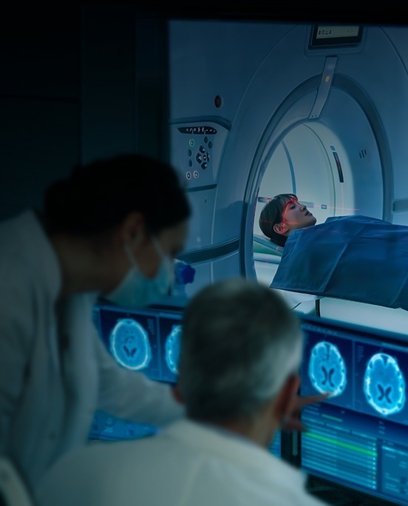

ADI’s Technology Empowers the Intelligent Edge …
… Where the Physical and Digital Worlds Intersect
INTELLIGENT EDGE
SYSTEMS
Sense
Interpret
Communicate
Learn
Decide
Act
DELIVERING
Autonomy
Sustainability
Connectivity
Security
Renewable Energy
Connected Humanity
Sustainable Automotive
Industrial Automation
Advanced Digital HealthCare
Immersive Consumer Experience
Notes:
ADI has built a long and successful history bridging the physical and digital worlds with products and solutions that sense, measure, compute, connect and power our world. Today, we are applying these core competencies to empower the Intelligent Edge.
Intelligent Edge Architecture​
Connecting the physical and digital worlds by both sensing and processing at the edge will make data and insights available where decisions are made, resulting in faster and more effective execution.​
ADI’s core technologies, embedded digital software, and platform stacks are key enablers to unlock insights from the edge.​

Slide 6
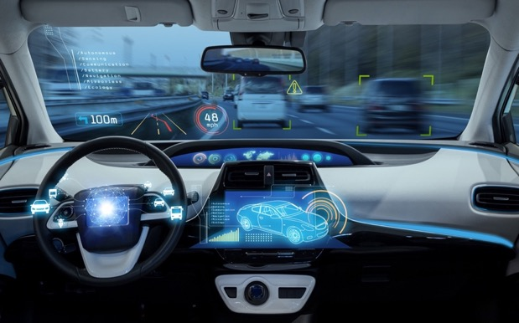
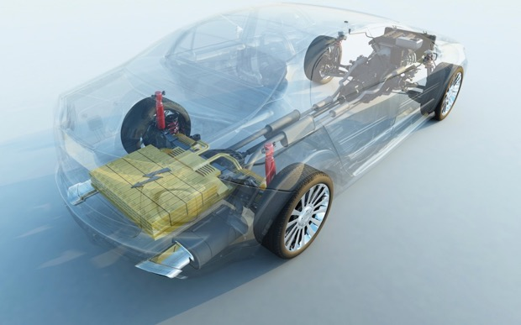


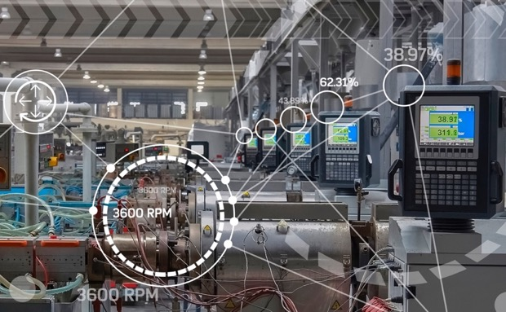

Technologies for Today’s and Tomorrow’s Innovations
Autonomous Transportation and Machines
Automotive Electrification
5G and Next-Gen Connectivity
Digital Health
Industry 4.0 and Smart Energy
Immersive Consumer Experiences
Notes:
As innovators at the Intelligent Edge, we bring vital intelligence to the technology that governs our daily lives. Our solutions harness and activate the data that make connected devices smarter and more responsive. From digitized factories, electrified and connected automobiles, healthcare, and energy to combating climate change and reliably connecting humans and the world, our analog, software, and digital solutions are at the forefront of the digital transformation.
We achieve this by collaborating with our customers, providing them with the technical expertise, support, and resources they need to overcome any challenge. Together, we deliver breakthroughs at the Intelligent Edge that help make our world safer, more efficient, and sustainable.

Slide 7







ADI’s Global Footprint
USE EITHER THIS SLIDE OR THE BOXED VERSION DEPENDING ON THE CLIENT
ADI Internal Sites
Foundries
External Assembly and Test
Improves Resiliency and Flexibility
Limerick, Ireland 3× Capacity
TSMC 0.6, 0.5, 0.35 Resiliency
Chelmsford, MA, USA Assembly & Test
OPERATIONS EMPLOYEES
Camas, WA, USA 2× Capacity
Vanguard 0.6 Resiliency
Beaverton, OR, USA 2× Capacity
TSMC 180 nm Resiliency
Full Conversion to 8"
Chonburi, Thailand Test
Cavite, Philippines 2 Test Sites 1 Assembly
Wilmington, MA, USA MEMS and Specialty Processes
Penang, Malaysia Probe, Assembly, Final Test
15k+
11
50+
Doubling capacity at internal fabs in U.S. and Europe
Expanding partnership with TSMC
Assembly and Test resilient to Taiwan/China
OPERATIONS EMPLOYEES
INTERNAL FACTORIES
SUPPLY CHAIN FACTORIES ACROSS 8 COUNTRIES

Slide 8

Worldwide Offices
KEY
Global Headquarters
Regional Offices
Canada
Japan
Korea
Taiwan
U.S.A.
Israel
Turkey
Egypt
Bermuda
Ireland
U.K.
Germany
Austria
Belgium
Denmark
Finland
Poland
Sweden
France
Italy
Netherlands
Romania
Spain
Switzerland
Slovakia
Mexico
China
India
Philippines
Malaysia
Singapore
Brazil
Australia
Notes:
Asa cum am mentionat si anterior, Analog Devices s-a extins global, avand sedii in peste 20 de tari, printre care si Romania.

Slide 9
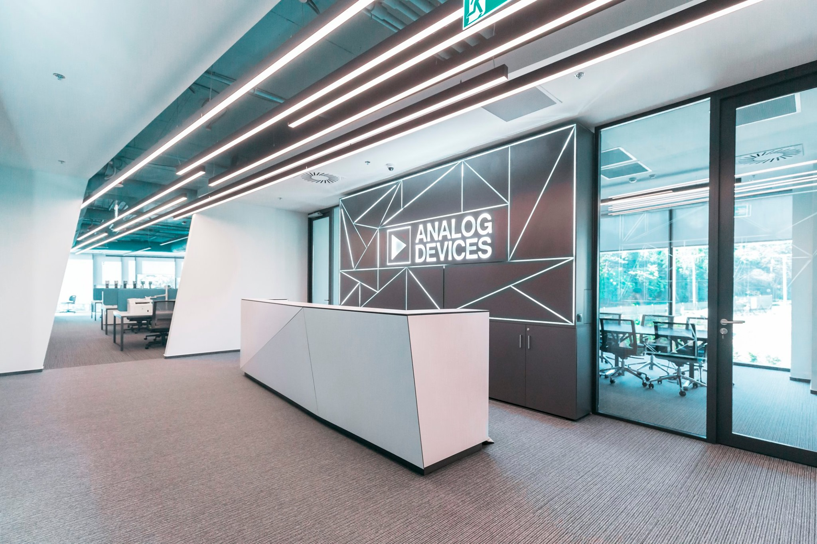
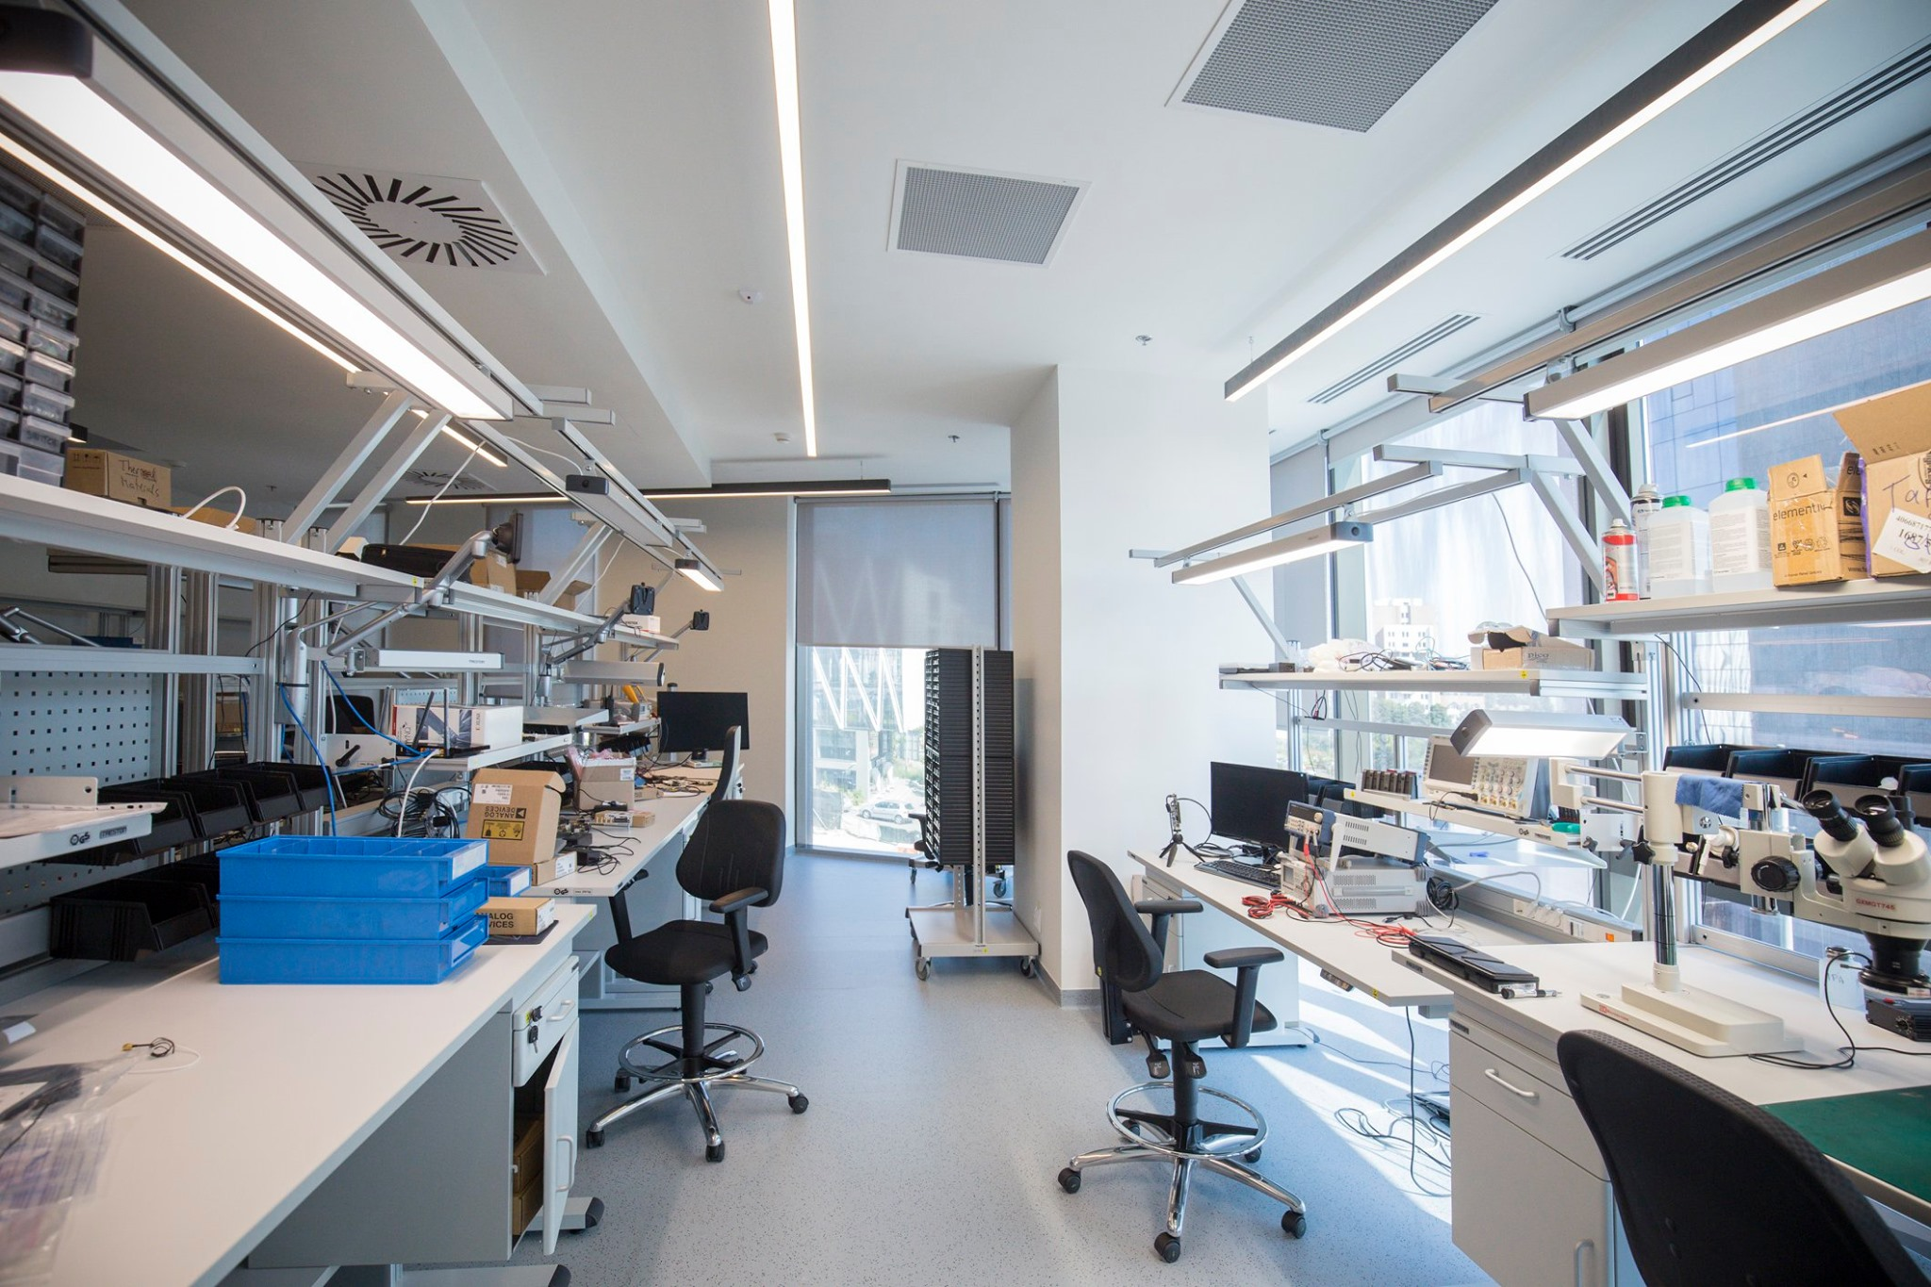
ADI Romania Design Center
Founded in 2011
Office 1 - UBC Riviera
1,000 square meters, 100 people capacity
Office 2 - UBC Tower
1,000 square meters, 120 people capacity
Multidisciplinary team
Hardware design
FPGA development (VHDL, Verilog)
Embedded software (C/C++, Linux)
Applications software (Python, MATLAB, C++)
Devops (Jenkins, Microsoft Azure, CI/CD)
System architecture
UX design
Program/Project management
Project fields
RF Communications
Precision & High-Speed Instrumentation
Depth, Perception and Ranging (ToF, LIDAR)
Industrial Automation

Slide 10
ADI Departments in Cluj-Napoca
Notes:
Echipa noastra din Cluj este impartita in 5 departamente
Hardware design
FPGA development
Embedded software
Applications software
System design and applications

Slide 11
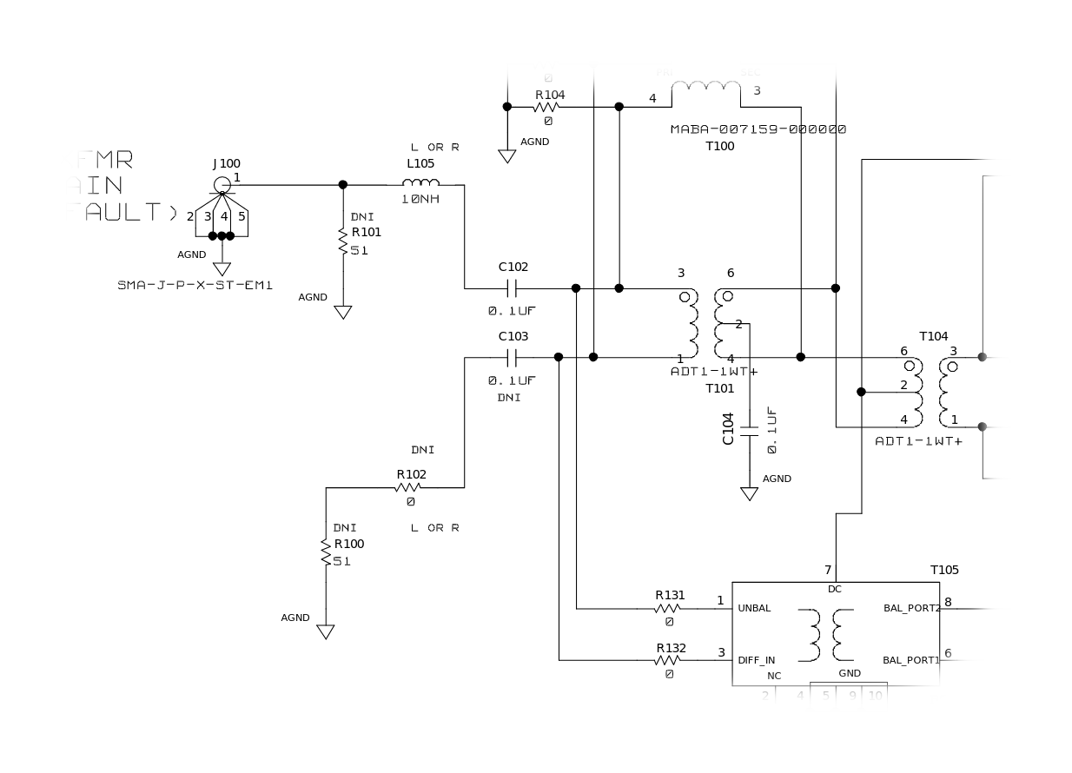
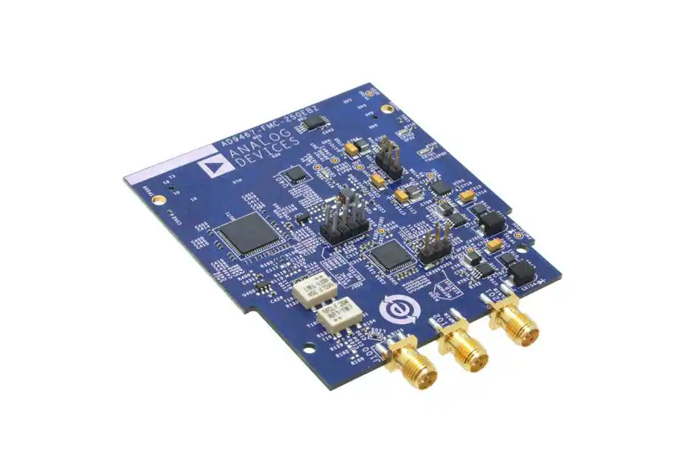
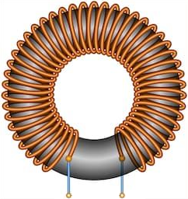
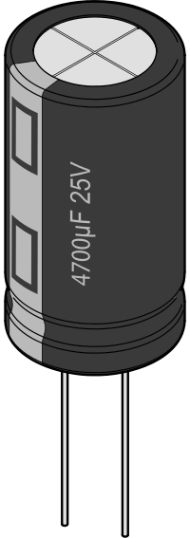
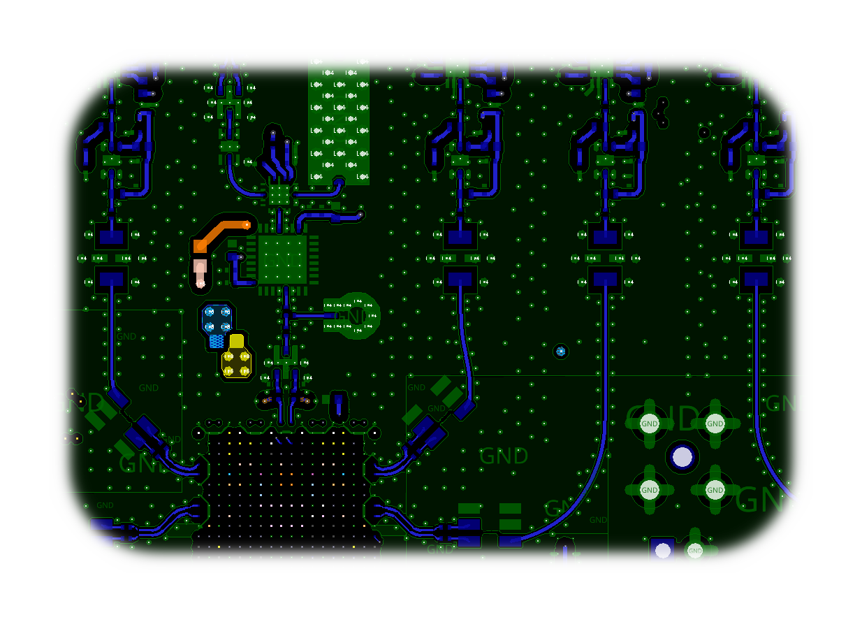

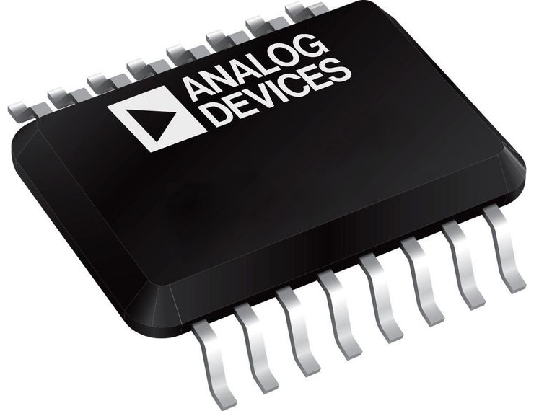
Hardware Department
Notes:
Departamentul de Hardware din Cluj se ocupa de alegerea componentelor ce urmeaza a fi integrate pe un PCB, construit in jurul circuitelor integrate produse de ADI, urmand sa implementeze apoi schematicul. Odata revizuit acesst schematic, se trece la partea de layout, oferind asadar solutii complete de implementare hardware, pentru a se ajunge la un produs finit precum cel pe care il puteti vedea in partea dreapta.

Slide 12
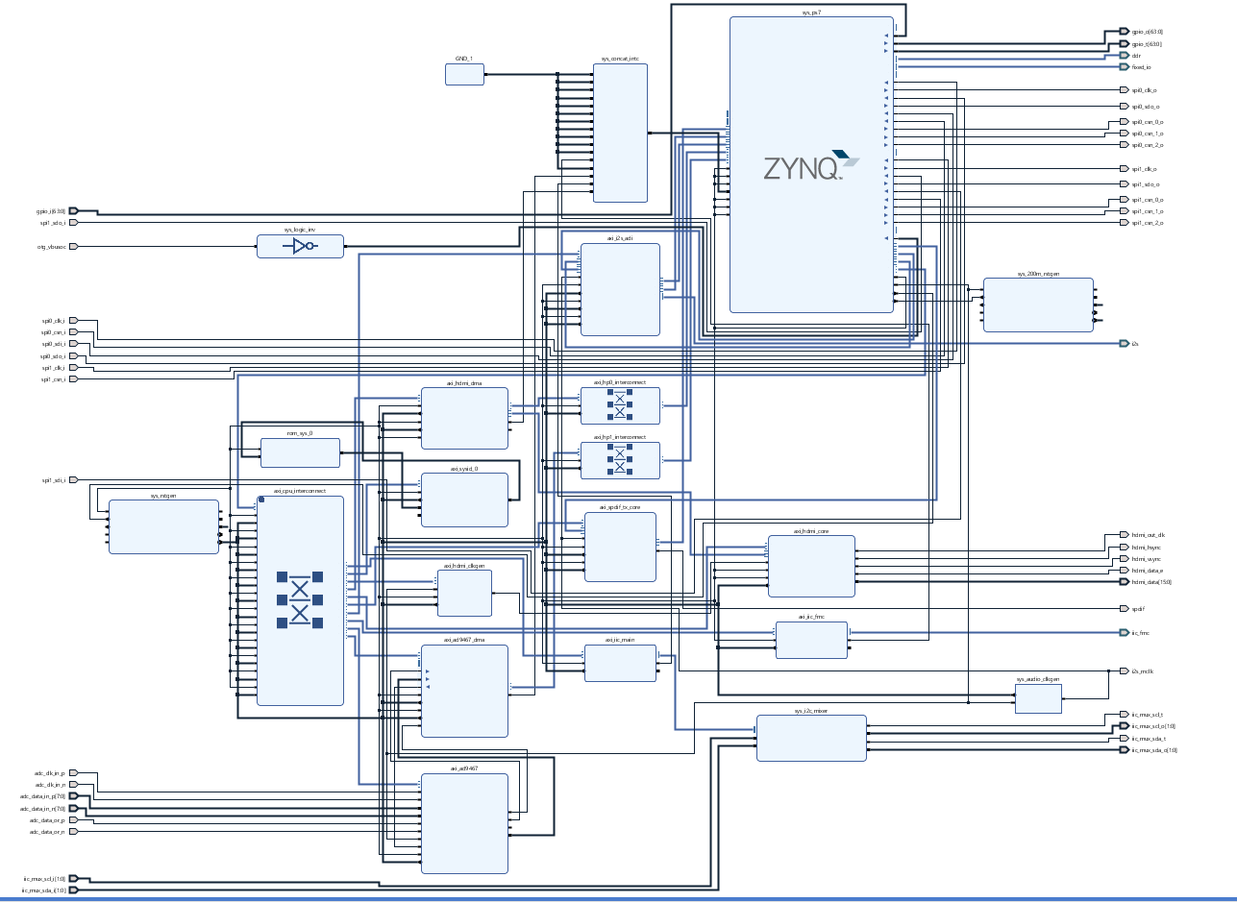
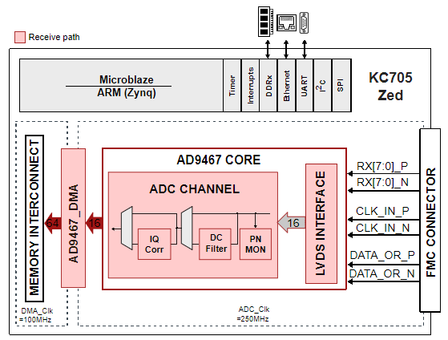
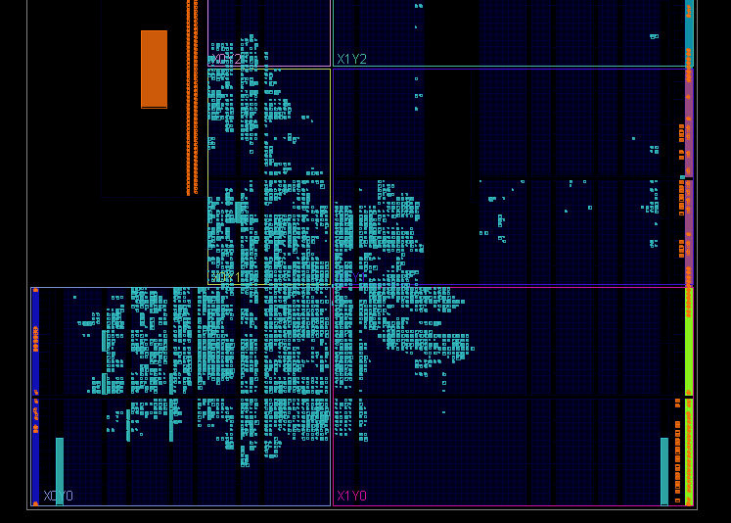

HDL Department
Notes:
Departamentul de HDL este responsabil pentru programarea de FPGA. Se porneste de la specifcatiile tehnice si de la schematic si se ajunge la un design de referinta, care ne dorim sa fie cat mai optim din punct de vedere al consumului de resurse si de putere. De asemenea, pe langa deisgnurile noi, ne ocupam si de partea de mentenanta, asigurandu-ne ca aducem toate proiectele deja existente la zi, pentru a fi compatibile cu cele mai noi versiuni ale toolurilor. O buna parte din ce facem e interfatarea cu chipurile/hardware-ul de care am vorbit inainte.

Slide 13
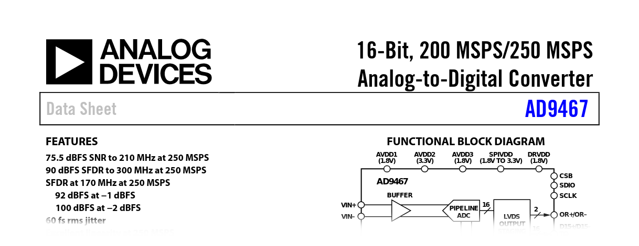
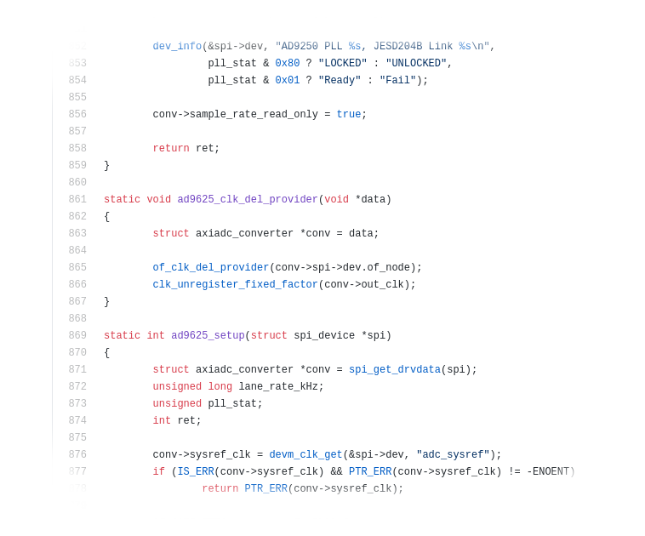

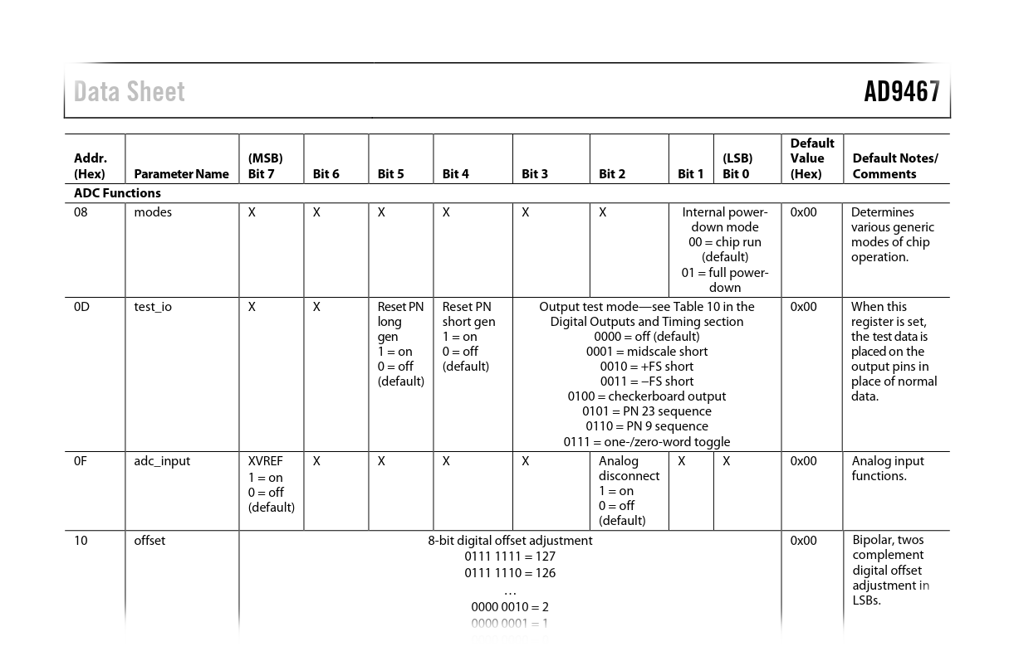

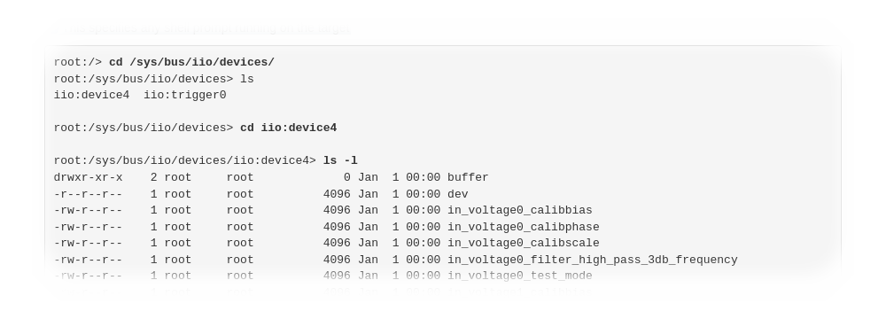
Embedded Software Department
Notes:
Pornind de la datasheet, de cele mai multe ori echipa de embedded software creeaza o interfata pe care utilizatorii o pot folosi pentru initializarea, configurarea si utilizarea componentelor. Exista doua mari tipuri de proiecte pe care lucreaza aceasta echipa: pentru platforme care utilizeaza un sistem de operare (si in cazul acesta, targetul nostru e Linuxul) si sisteme baremetal.

Slide 14
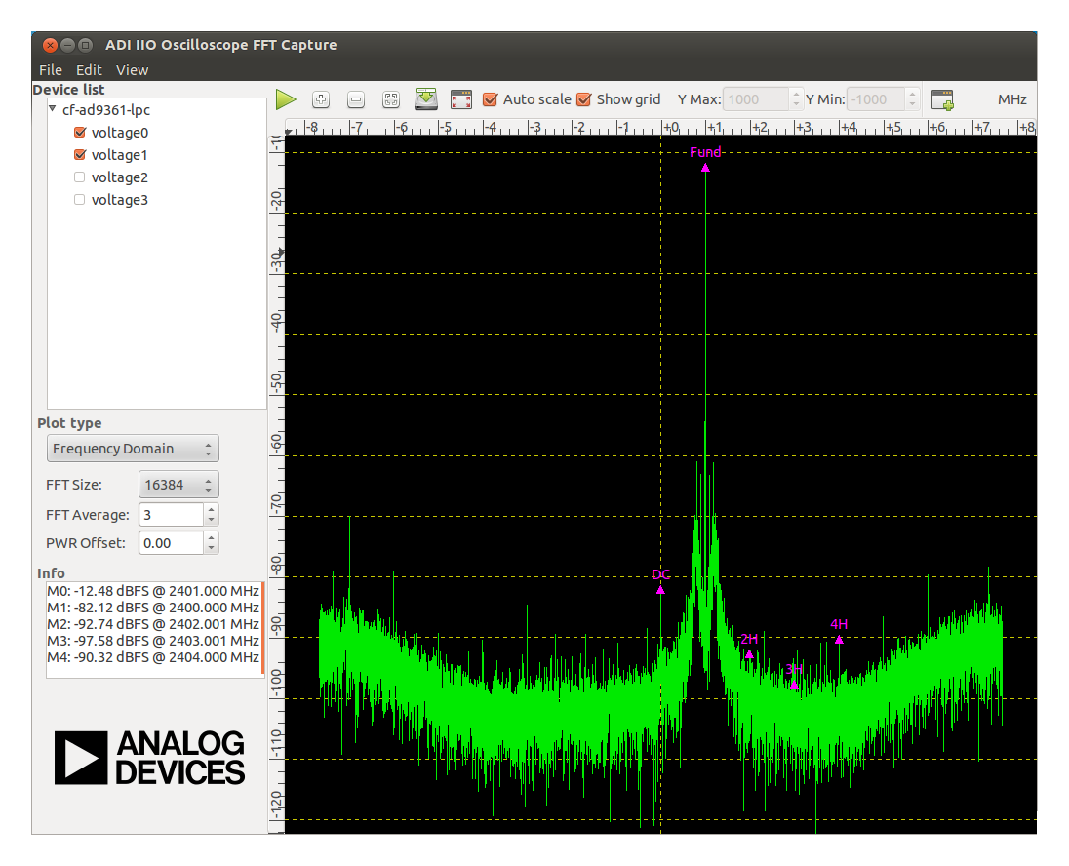
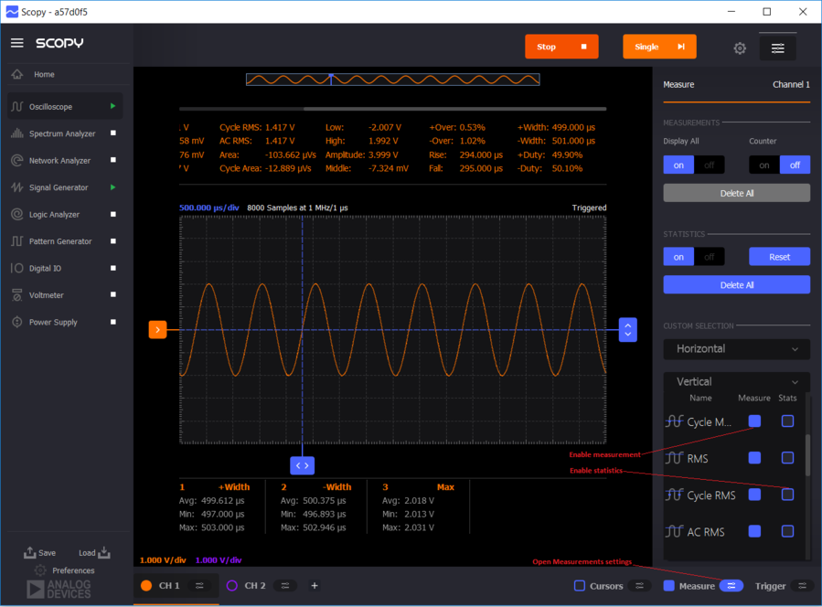
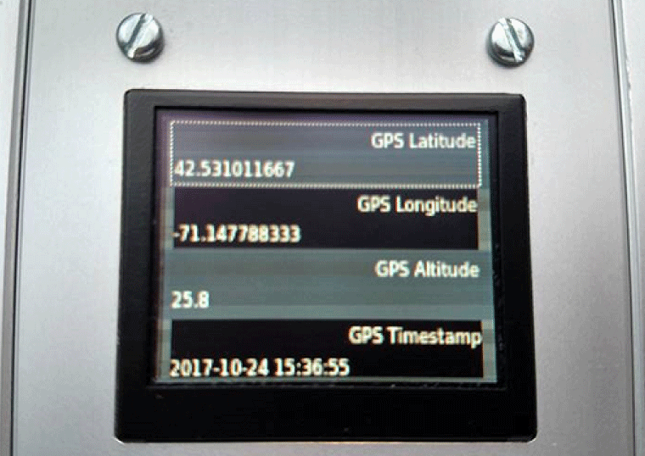
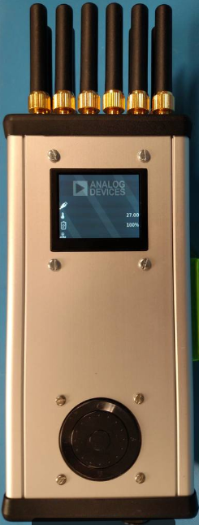
Applications Software Department
Notes:
Departamentul de Applications Software, asa cum ii spune si numele, se ocupa de aplicatiile pentru interfata cu utilizatorul. Cele mai populare dintre acestea sunt Scopy, care prezinta toate functionalitatile unui osciloscop, generator de semnal si de patternuri, voltmetru si multe altele, cat si IIO Oscilloscope, care de asemenea se foloseste ca osciloscop pentru a evalua datele primate de la device-urile noastre. De mentionat este ca accentul nu se pune doar pe partea de grafica, ci pe partea de software din spatele acestor aplicatii.

Slide 15
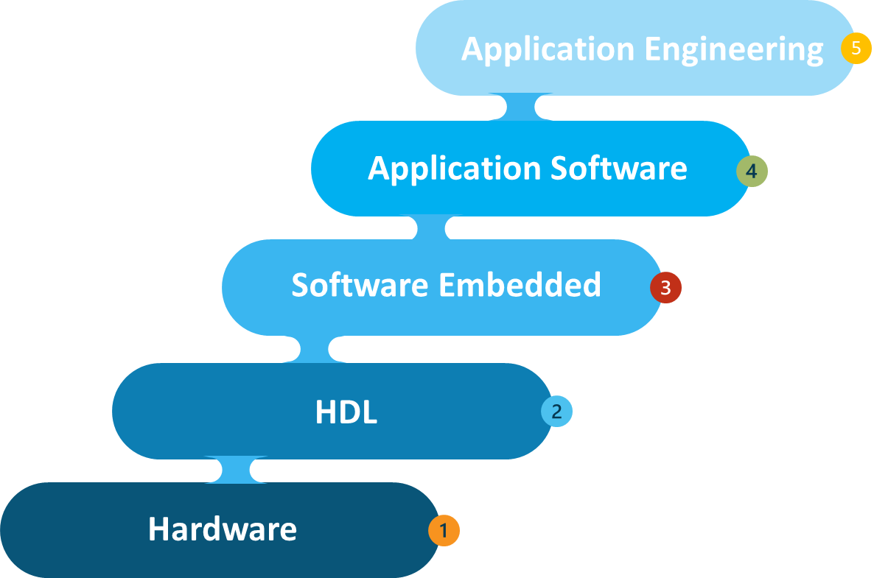

Application Engineering Department
Project demos
Trainings/Student workshops
Summer practice
Production testing
Tradeshows participations

Slide 16




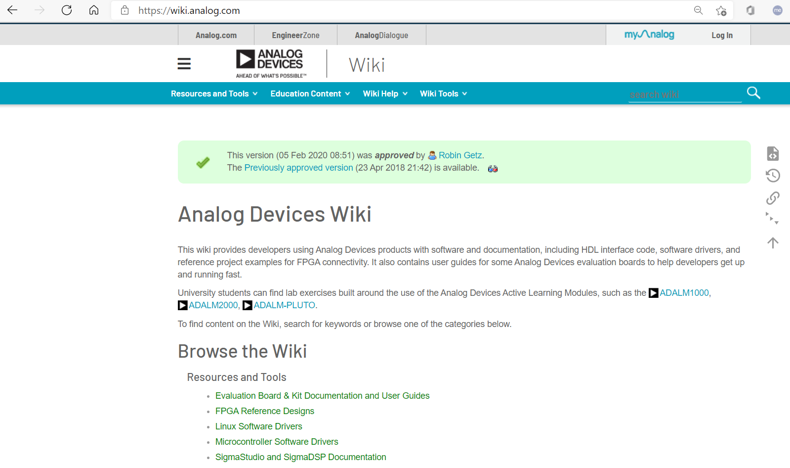
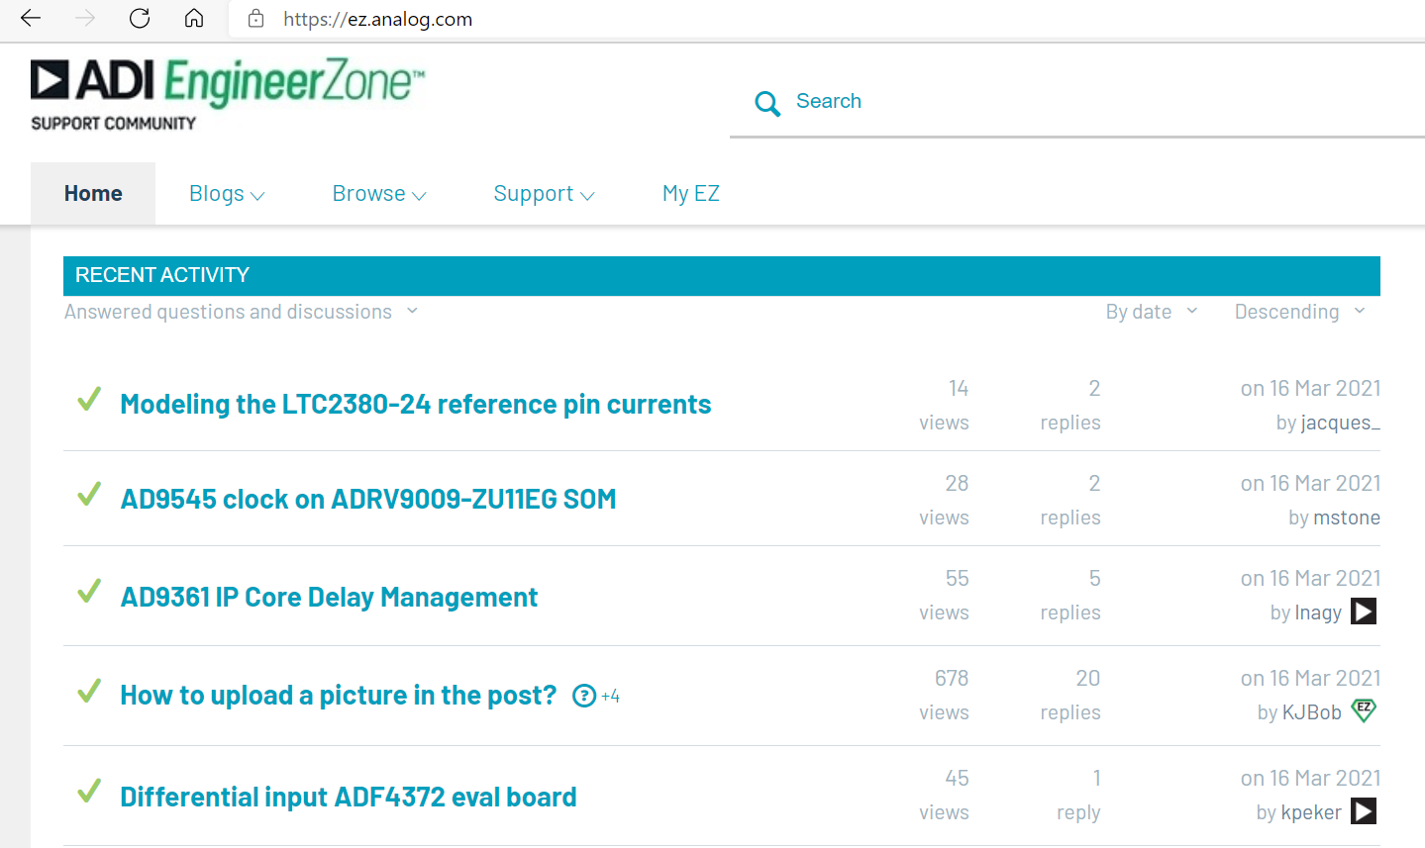
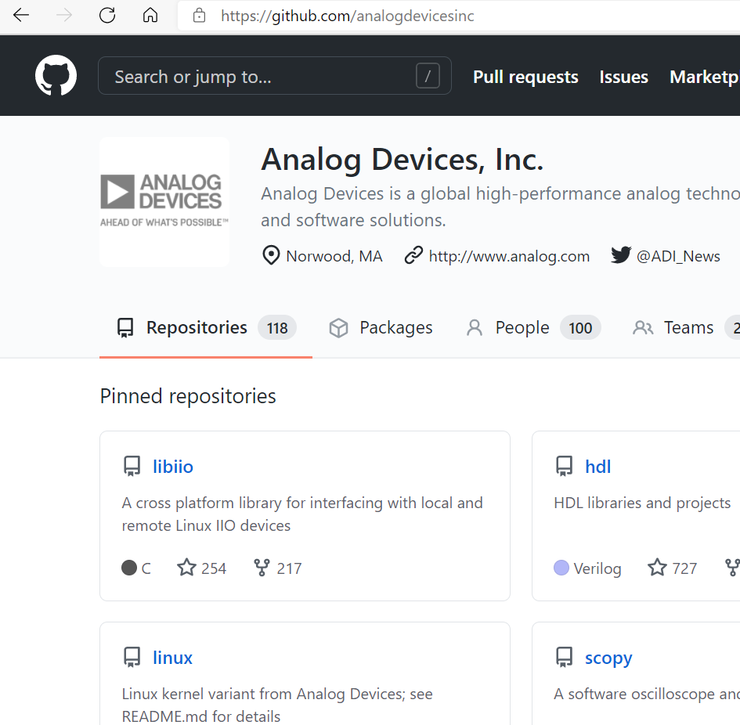
Community
Connect with Engineering Experts and Resources
Access Exclusive Content to Stay Informed
wiki.analog.com
github.com/analogdevicesinc
ez.analog.com

Slide 17






Software Platforms & Resources
Hardware
HDL
Embedded Software
High-level Software
Notes:
Hardware Design:
3d mechannical design
Python
Basic linux
Soldering
HDL Design:
Xilinx Vivado, Intel Quartus
Verilog, SystemVerilog, TCL, basic shell scripting, perl
Embedded Software:
Software development languages: C, C++, Python, shell scripting
Linux Kernel and Driver Development
Baremetal Driver Development
Applications software development:
C/C++/Python/MATLAB si pt frameworks poti trece Qt/ OpenCV (pe parte de ToF)/ Open3D/ rOS / GNURadio

Slide 18
Overview of
industrial control
and automation systems

Slide 19

Overview of industrial control and automation systems
The use of control systems (computers, PLCs and robots) for handling industrial processes
Improves efficiency, quality and safety while reducing costs
Used for automated assembly lines, process control in refineries
Notes:
- Controlul industrial si sistemele de automatizare sunt esentiale in gestionarea proceselor industriale: putem monitoriza procesele si le putem gestiona
-scop: cresc eficienta sistemelor, siguranta si reduc costurile
- Un exemplu de domeniu in care folosim control industrial este la liniile de asamblare, la controlul proceselor din rafinarii
Q: imi poate da cineva exemplu de alte domenii in care avem nevoie de control industrial si automatizari?

Slide 20
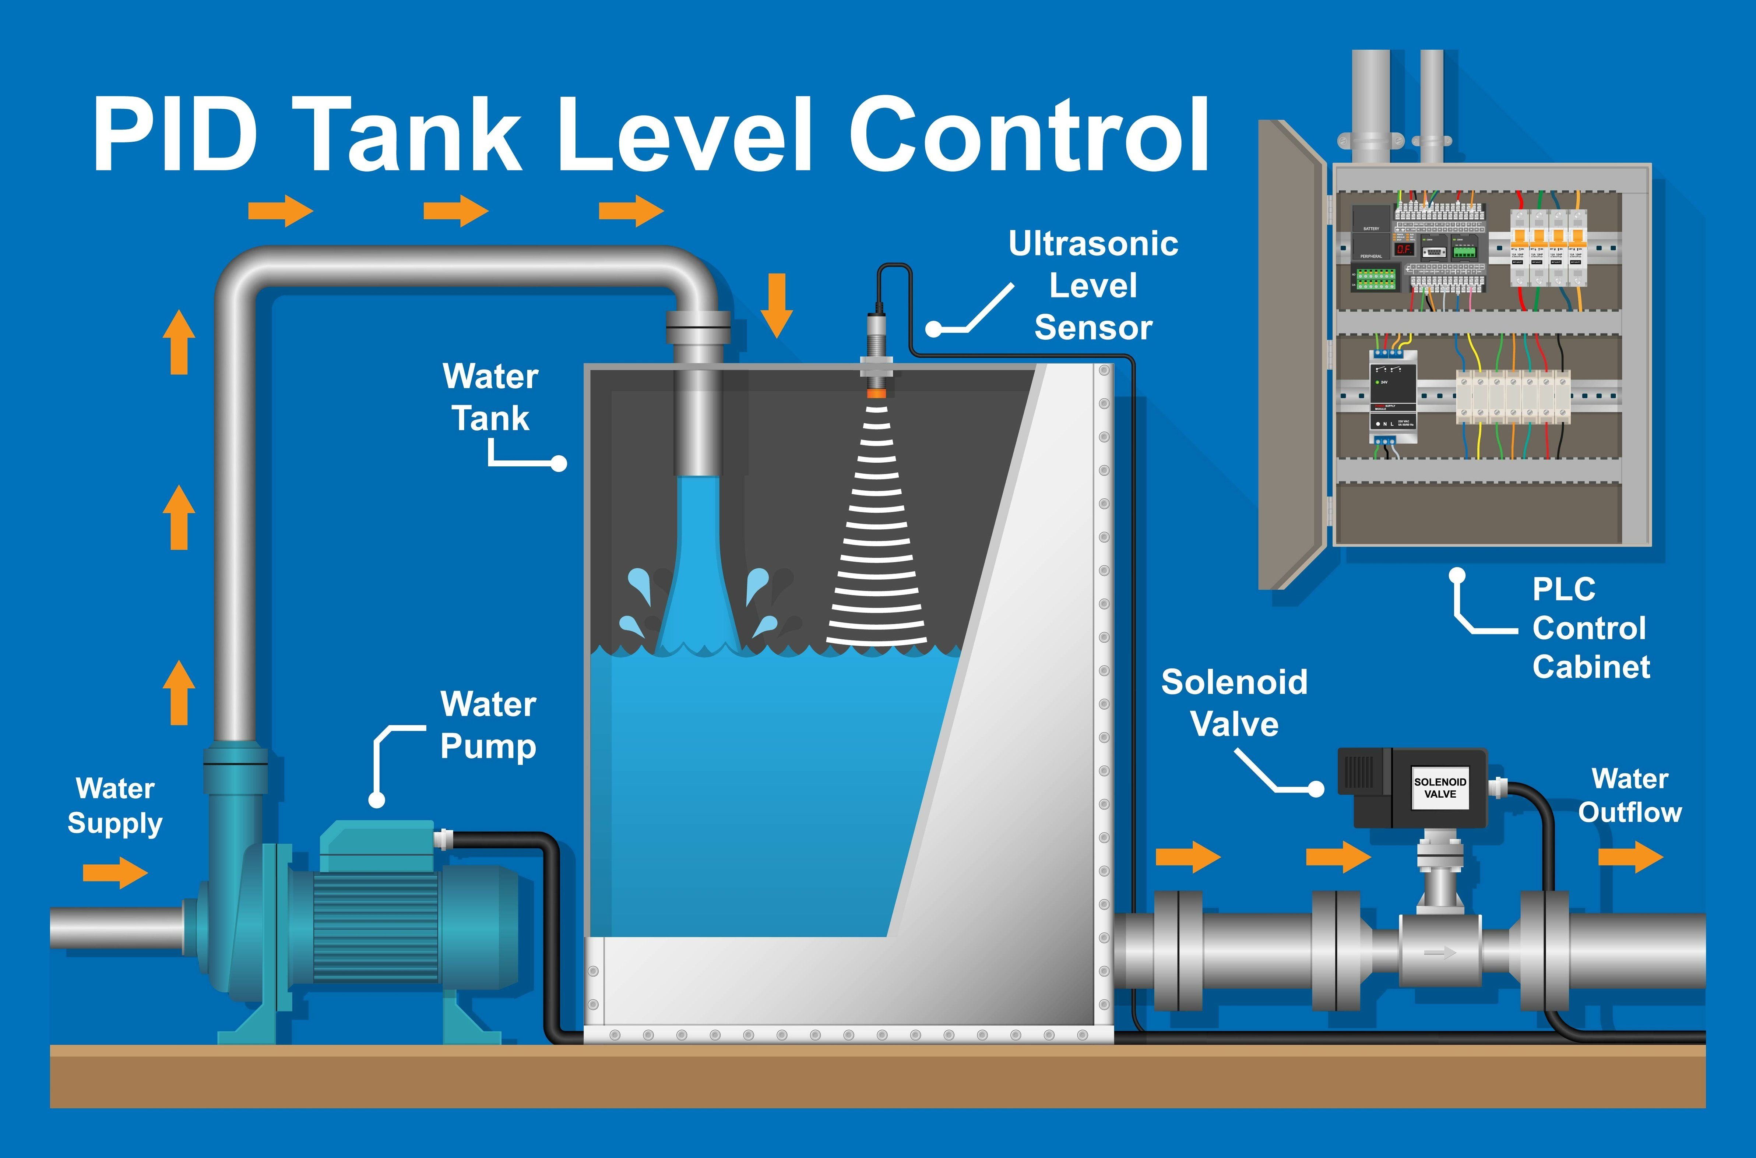
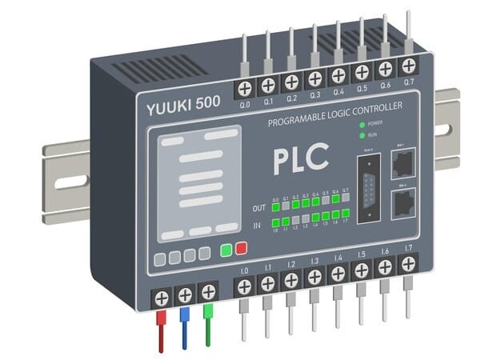
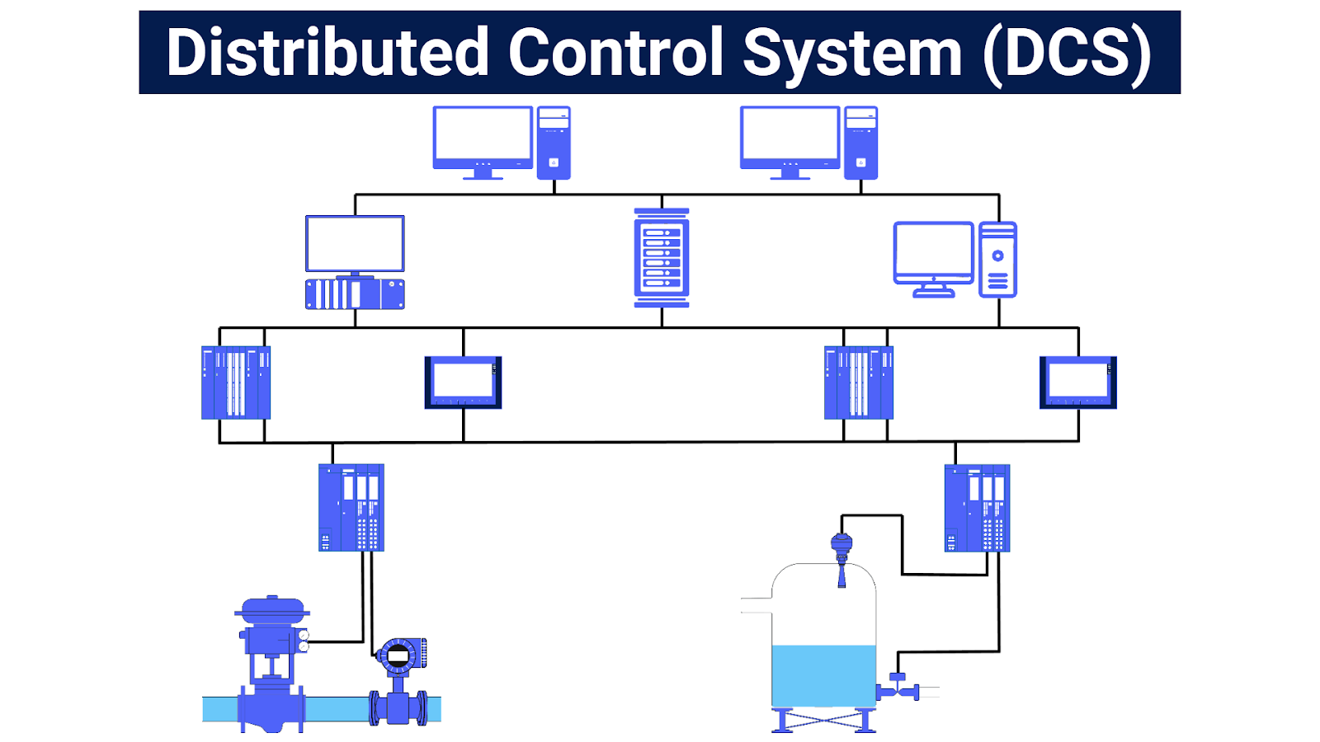
Industrial control systems
SCADA(Supervisory Control and Data Acquisition) Systems
Programmable logic controllers (PLC)
Distributed control systems (DCS)
Proportional-integral-derivative controllers (PID)
Programmable automation controllers (PAC)
Notes:
Ce sunt sistemele de control industrial? Un sistem de control este un grup de dispozitive mecanice și/sau electronice care controlează alte echipamente sau sisteme astfel încât să controleze un echipament specific sau diferite mărimi de proces cum ar fi de exemplu temperatură, umiditate, debit,
Exemple de sisteme:
SCADA(Supervisory Control and Data Acquisition): are ca scop monitorizarea si controlul dispozitivelor de teren (in proximitatea sistemului sau de la distanta) -> urmarirea, colectarea si procesarea de date in timp real si interactionarea cu senzori prin software-ul SCADA. Datele vizualizate in HMI
PLC(Automate programabile) sunt niste dispozitive modulare, de diferite dimensiuni, care includ un microprocessor cu un anumit numar de I/O de la zeci la sute. O componenta de baza a sistemelor industrial
DCS(sisteme de control distribuite): au scop similar cu PLC-urile de a controla, monitoriza echipamentele industrial. Diferenta ar fi ca DCS-urile au mai multe controllere care distribuie sarcinile la nivelul intregului sistem, in timp ce la PLC-uri avem un singur controller centralizat, deci il vom folosi la structuri de control mai simple si sarcini bine definite
PID: despre care vom vorbi mai multe ulterior
PAC(programmable automation controller): imbina caracteristicile unui PLC si ale unui PC pentru a oferi un control mai flexibil si perfomant

Slide 21
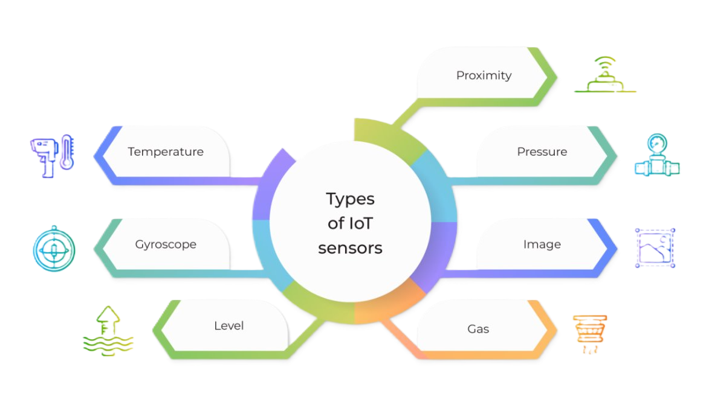
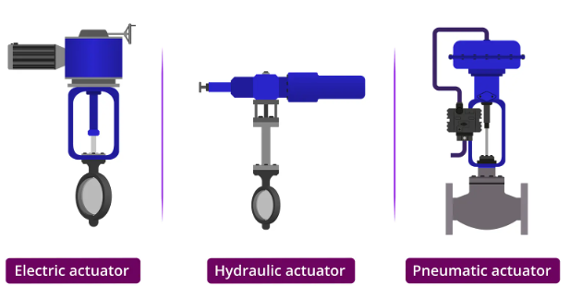
Industrial automation components
Sensors
Notes:
Senzori: pentru a detecta modificari in mediul inconjurator. Exemple de senzori?
Actuatoare: transforma semnalele electrice in miscare fizica/actiune

Slide 22
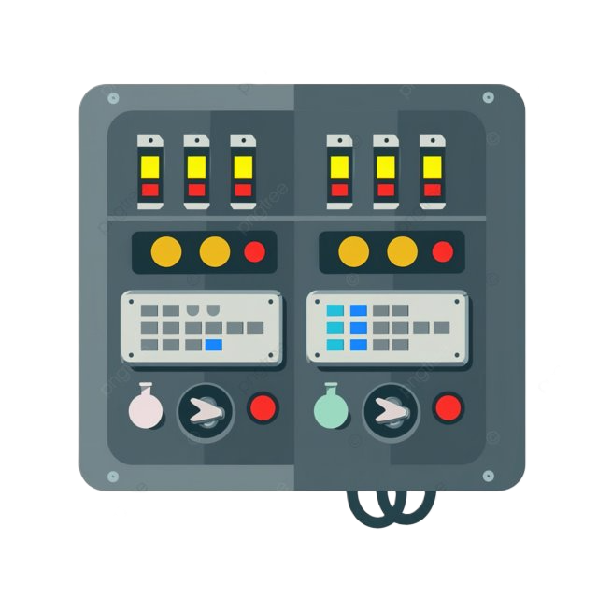


Industrial automation components
Programmable Logic Controllers (PLCs), Distributed Control Systems (DCS), and microcontrollers.
Graphical user interface for operators to monitor and interact with the automated system
Ethernet, Fieldbus, Profibus, Modbus, and wireless networks
Notes:
PLC, DCS, microcontrollere: creierul operatiunilor industrial au ca scop executarea algoritmilor de control pentru procese
Interfata grafica: permite utilizatorului sa interactiuneze cu sistemul
Protocoale de comunicatii: Ethernet, Fieldbus, Profibus, Modbus(protocoale industriale utilizate în automatizări și controlul proceselor), retele network. Protocoalele stabilesc reguli comune, astfel incat dispozitivele diferita sa poata “vorbi” intre ele. Fara protocoale, fiecare dispozitiv ar comunica in propriul format, rezulta interconectare dificila. Ele se asigura ca mesajele ajung la destinatie fara erori, ca sunt criptate.
Q: mai stiti alte protocoale de comunicatii? HTTP, TCP/Ip

Slide 23
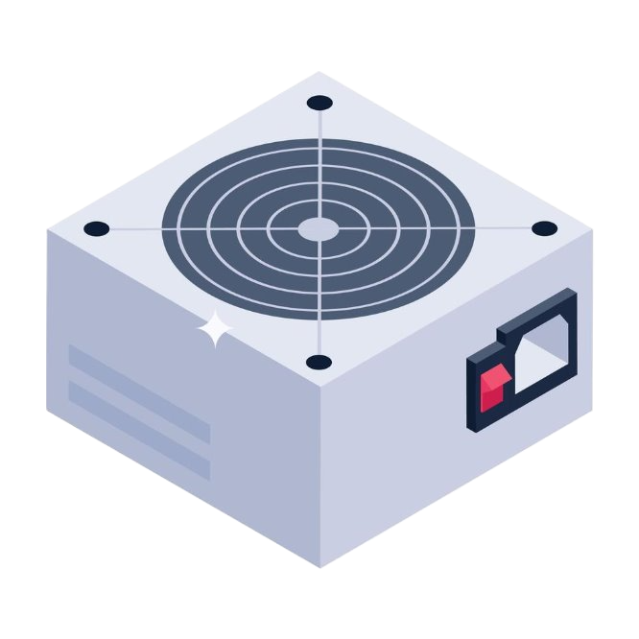
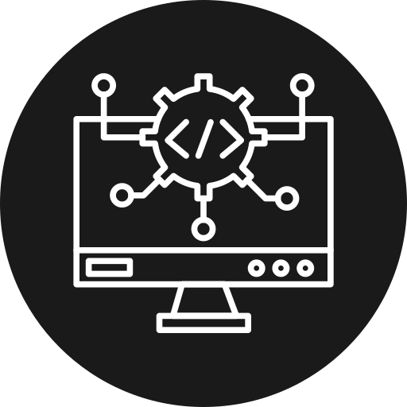
Industrial automation components
Power supply units
Software and Control Algorithms
Notes:
Alimentari
Algoritmi de control: programeaza si configureaza task-uri ale sistemului. Esentiale pentru a defini cum raspunde sistemul in diferite situatii.

Slide 24

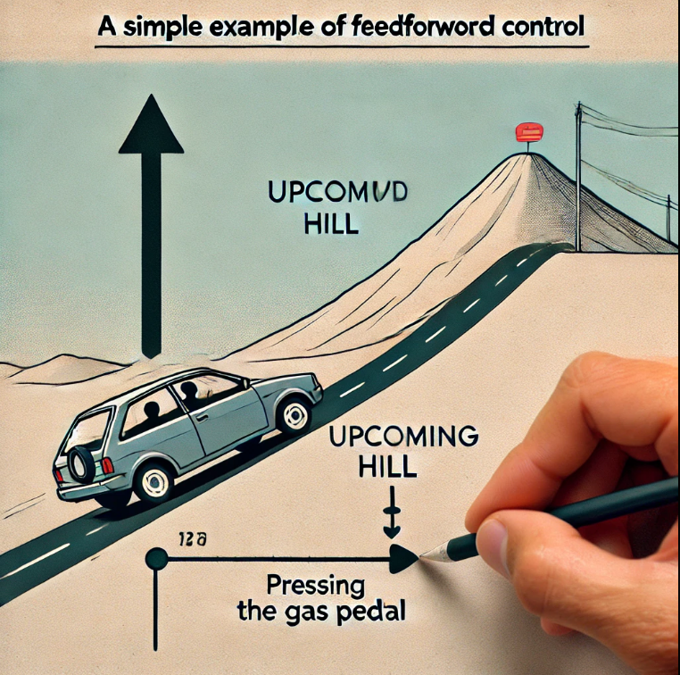

Common Control Strategies
PID Control (Proportional-Integral-Derivative)
On-Off Control
Feedforward Control
Cascade Control
Notes:
PID: cel mai des intalnit in industrie. Ajusteaza variabilele de proces continuu pentru a obtine un anumit output.
On-OFF: dupa cum ii spune si numele, pornim oprim, e simplu si economic. Imi puteti da un exemplu? Thermostat
Feedforward: se anticipeaza si sistemul reactioneaza proactiv nu reactive
Cascade control: mai multe controller asezate in ierarhie

Slide 25
PWM Control
Notes:
Stie cineva ce inseamna PWM?

Slide 26
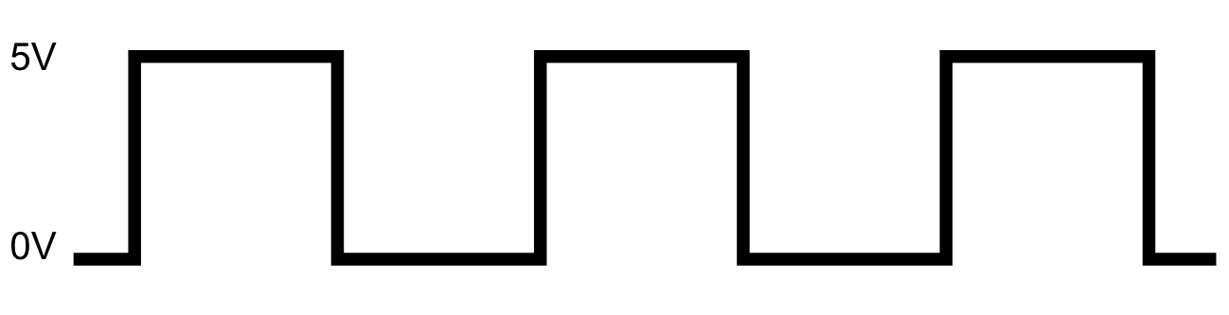
What is PWM?
Pulse-width modulation
Digital signal
Applies regulated voltage in short bursts -> pulses
Only high/low (1/0)
Notes:
-un semnal digital care ne permite sa lucram cu dispozitive analogice
-practic se genereaza u semnal digital care oscileaza intre 2 niveluri (ON/OFF), intr-un ciclu repetitiv
- exemple unde se foloseste Pwm? Ctrl viteza motoare, led-uri, convertoare DC-DC: PWM este utilizat în convertoarele de tensiune pentru a transforma o tensiune DC la o altă valoare (de exemplu, convertoare buck, boost sau buck-boost). Aceasta este esențială în dispozitive electronice alimentate de la baterie pentru a eficientiza consumul

Slide 27
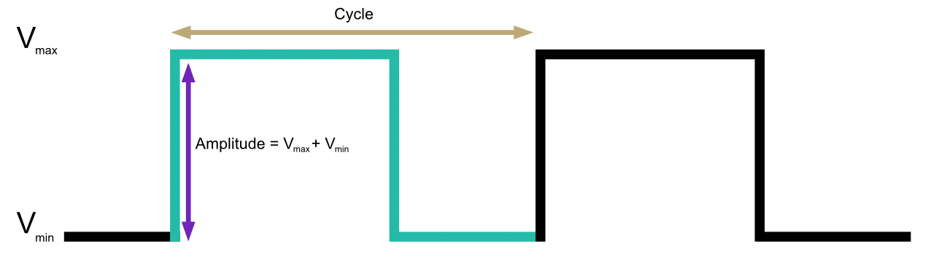
What is PWM?
Notes:
- suma dintre timpul de on +off = perioada

Slide 28
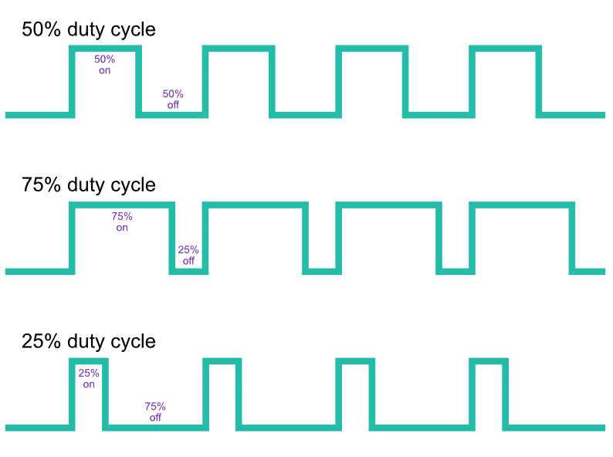
Duty Cycle
ON time: the amount of time the signal is high during a period
OFF time: the amount of time the signal is low is called “off” time
measured in percentage
Notes:
stie cineva sa-mi explice ce e duty cycle-ul?
- am vorbit de timpii de on si off care adunati ne dau o perioada -> raportul dintre durata in care semnalul e on si durata totala a ciclului. Duty cycle 75%? 75on, 25off

Slide 29
PID Control
Notes:
Un controller in bucla inchisa, monitorizeaza eroarea si pe baza ei calculeaza niste termeni P,I,D. Contoller-ul aduna aceste valori si ofera valoarea de output.

Slide 30
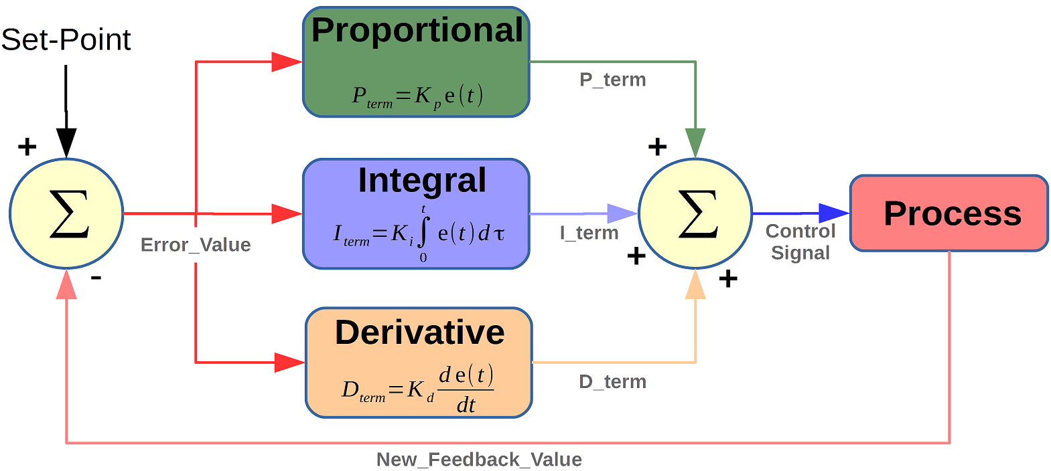
Proportional-integrative-derivative control
A PID controller: a controller used in automation to control an output and bring a process value to the desired set point
Notes:
P: termenul asta e direct propr cu eroareP roportional Gain (Kp): This parameter determines the proportion of the error signal contributing to the controller output. A higher Kp value results in a stronger response to the current error. Too high a Kp can lead to oscillations or instability, while too low a value can result in a sluggish response.
I: calculează suma erorilor acumulate de-a lungul timpului, fiind responsabilă pentru eliminarea erorii statice (offset) și îmbunătățirea acurateței pe termen lung a sistemului. Integral Gain (Ki): The integral term considers the accumulation of past errors and amplifies them over time. It helps eliminate steady-state error by continuously adjusting the control signal. A higher Ki value helps reduce steady-state error but can lead to overshoot or instability if set too high.
D: responsabilă pentru a prezice tendința viitoare a erorii, adică cât de repede și în ce direcție se schimbă eroarea. este proporțional cu rata de schimbare a erorii în timp, adică cât de rapid crește sau scade eroarea.

Slide 31
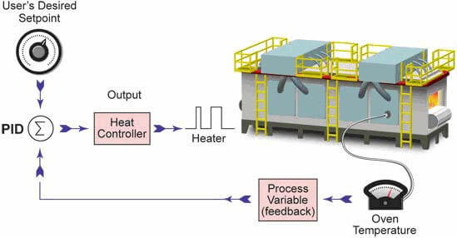
Proportional-integrative-derivative control

Slide 32
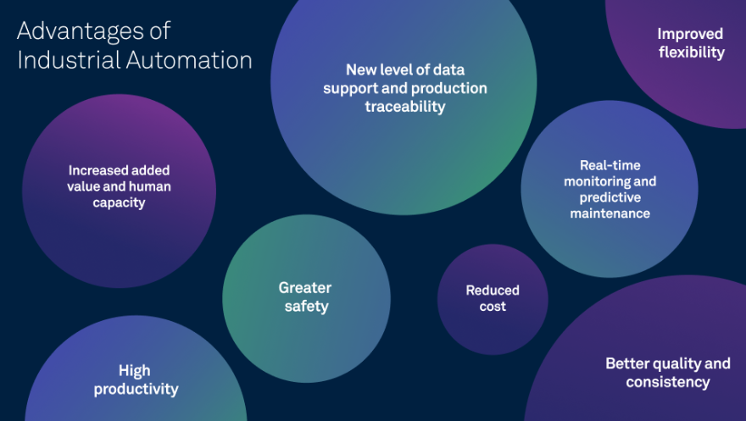
Advantages

Slide 33
AD-SWIOT1L-SL

Slide 34
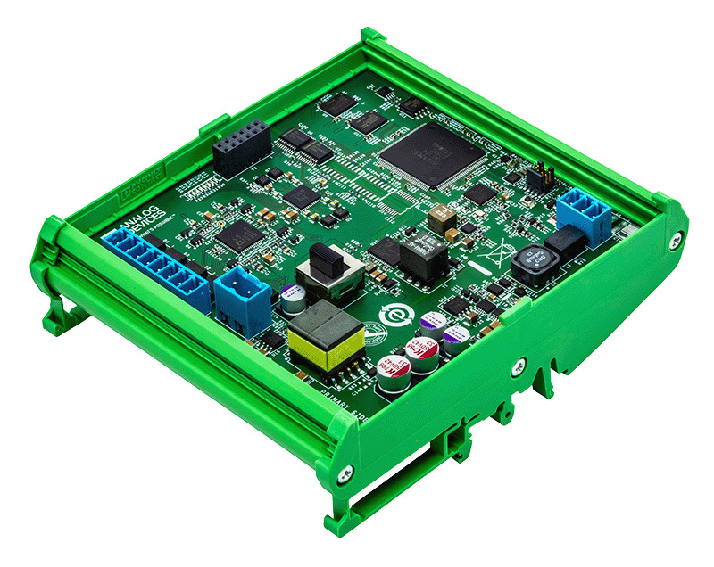
AD-SWIOT1L-SL
System-level reference design for prototyping field devices
4 x software configurable IO channels
Processing at the edge
Built-in security
10BASE-T1L interface
IO-Link expansion PMOD connector
Field & SPE power
Fully isolated design
Industry standard form factor for DIN rail installation
Open-source hardware design
Open-source software stack
Reflective of real customer use cases

Slide 35
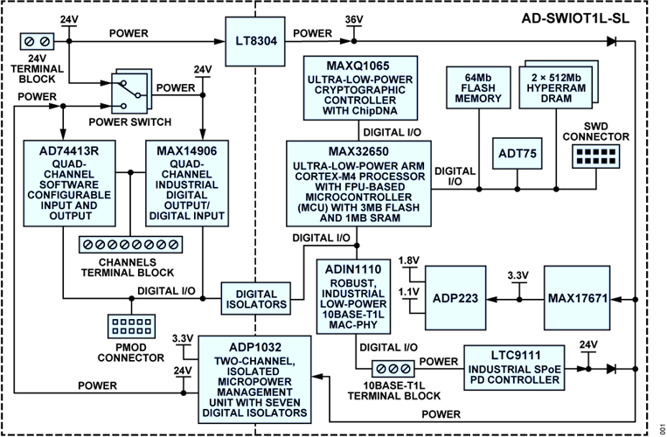
Block diagram & Specifications
IO
Channels | 4 Software configurable channels
Digital Input | Type 1 and 3, or Type 2
Digital Output | High-Side (HS) Switch or Push-Pull (PP) Driver
Analog Input | Voltage (0V to 10V), Current (0mA to 25mA)
Analog Output | Voltage (0V to 11V), Current (0mA to 25mA)
RTD measurements | 2-wire RTD (0Ω to 1MΩ)
Computing Resources
CPU | MAX32650 Ultra-Low-Power Arm Cortex-M4 with FPU0Based Microcontroller (MCU) with 3MB Flash and 1MB SRAM
Memory | 1 Gb RAM
Storage | 64 Mb QSPI Flash
Connectivity
Ethernet | 10BASE-T1L
IO-Link | Via IO-Link Pmod
Power Supply
External power | 24V DC @ 6A
Power over Ethernet | SPoE class 12
Operating conditions
Temperature range | -25°C to 60°C

Slide 36
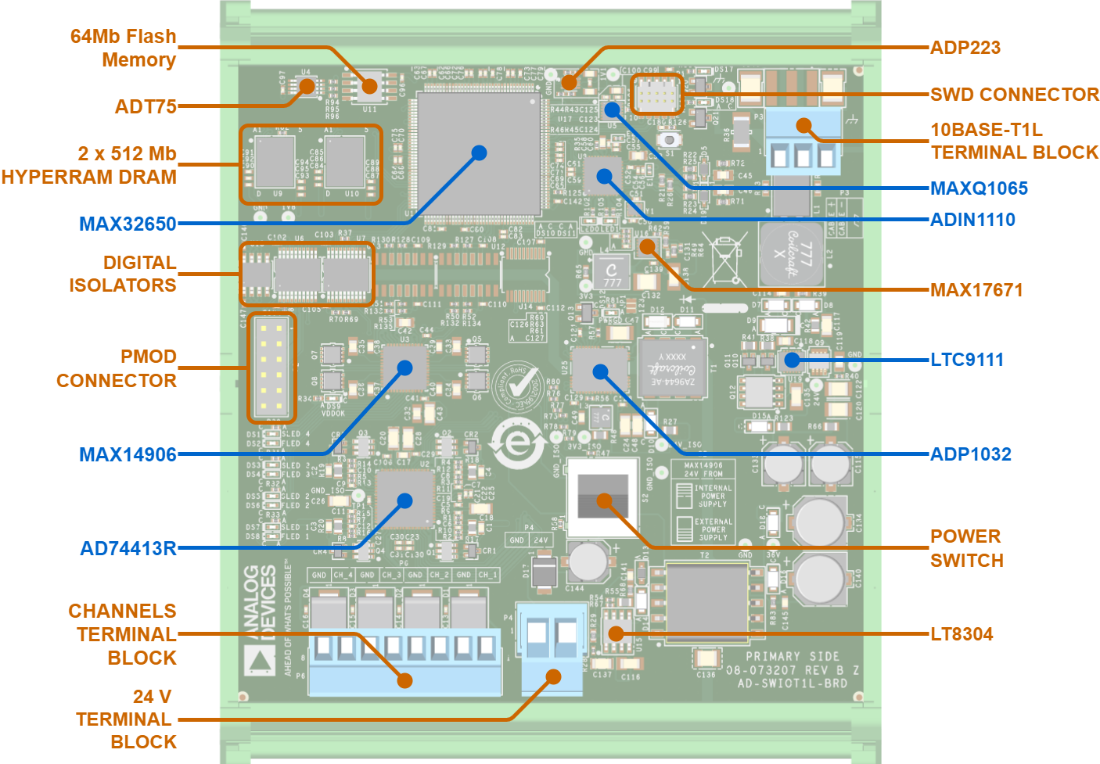
Board design

Slide 37
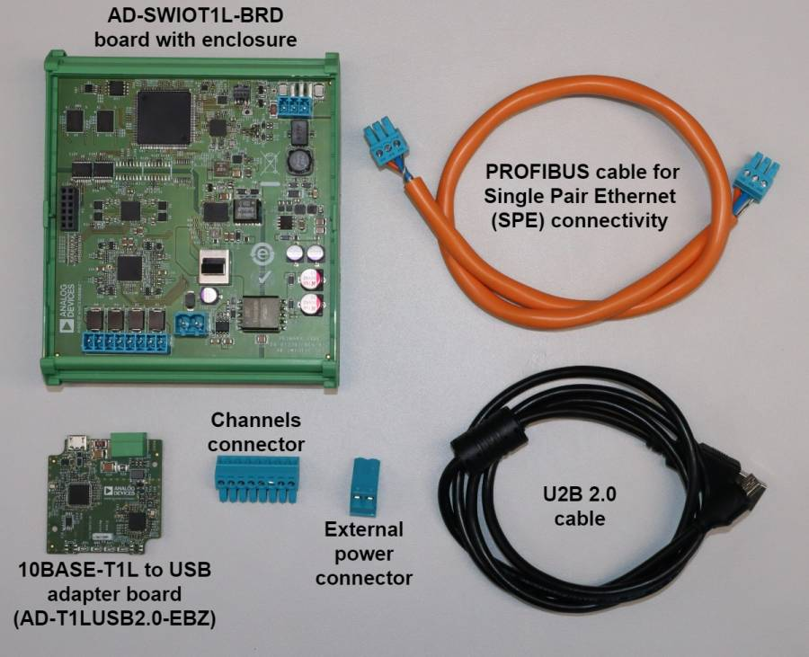
Kit contents
1 x AD-SWIOT1L-BRD board with enclosure
1 x 10BASE-T1L to USB adapter board
1 x PROFIBUS (1x2x18AWG) cable for Single Pair Ethernet (SPE) connectivity
1 x USB 2.0 cable
1 x cable connector for the external 24 V power supply
1 x cable connector for channels connectivity

Slide 38
Channels connections diagram
POT
LED Blue
LED Green
LED Red
GND
CH4
GND
CH3
GND
CH2
GND
CH1

Slide 39
Hands-on activity

Slide 40
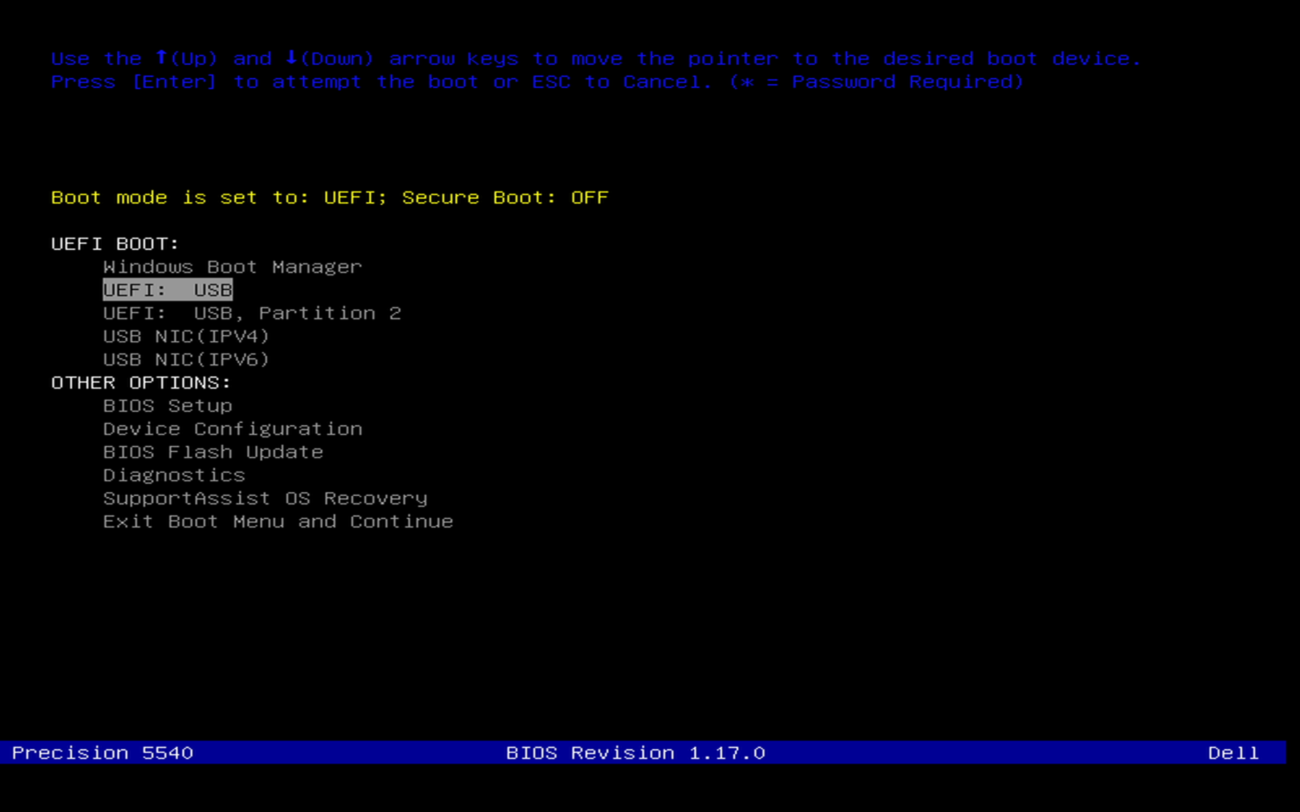
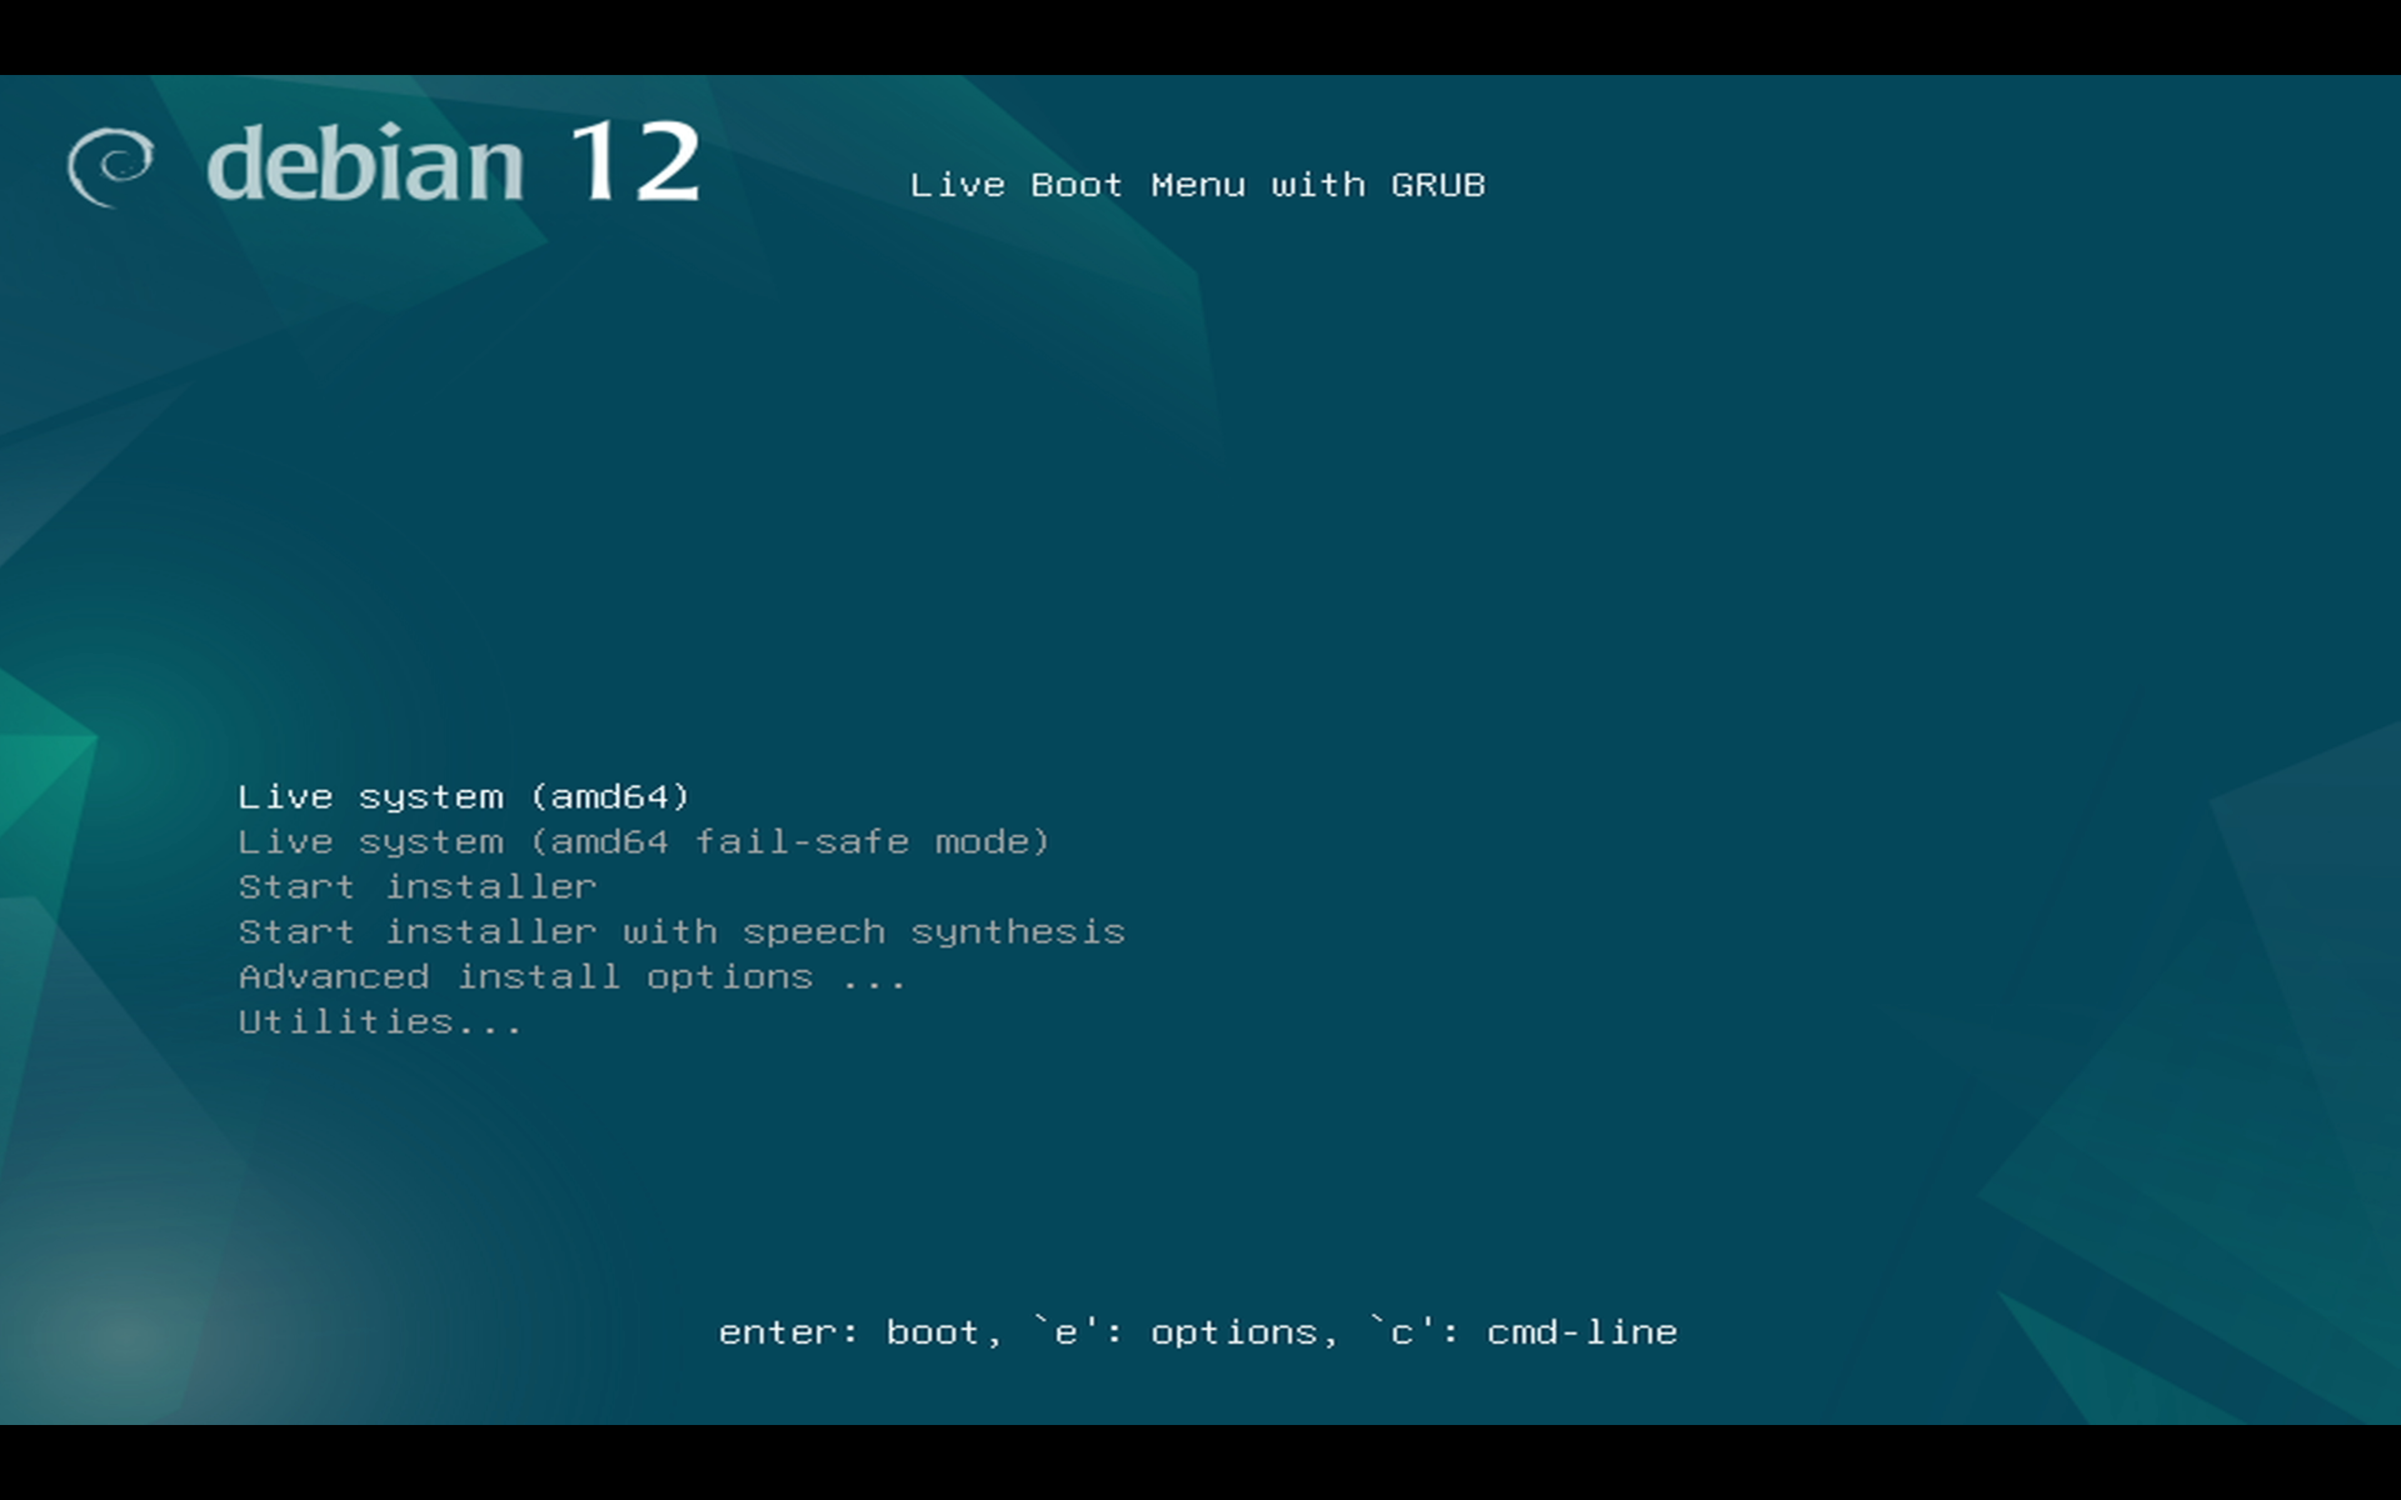
Booting your PC in Linux
Insert the USB stick
Power the laptop/PC
Keep pressing F12 to get the boot menu
When prompted select the Live system (amd64) option

Slide 41
Setting up your system
Power the AD-SWIOT1L-SL board by plugging in the power connector.
Connect the USB to T1L media converter to your PC and the AD-SWIOT1L-SL board. After a short time, both link status LEDs (on the media converter and the AD-SWIOT1L-SL board) should be up.

Slide 42
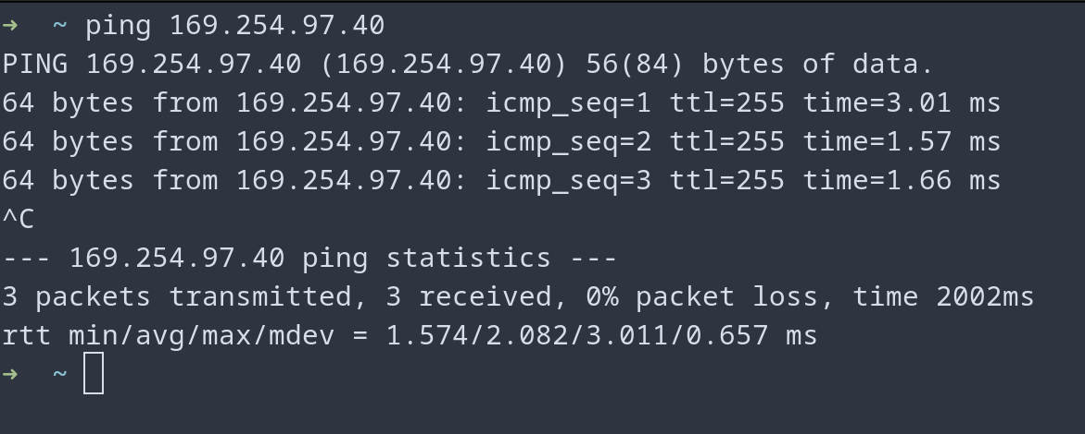
Testing the board connectivity
The connection to the board may be tested by trying to ping it.
Open a terminal from the Activities Menu (upper left corner) and ping the IP
This usually rules out the host (PC) network configuration issues.
Move to the workshop directory:
cd automation_workshop/pyadi-iio/examples/workshop

Slide 43
"No device found error" solutions
Plug out and plug in the board
run in the terminal: sudo ip route add 169.254.97.40 dev eth0
If nothing works, ask for help

Slide 44
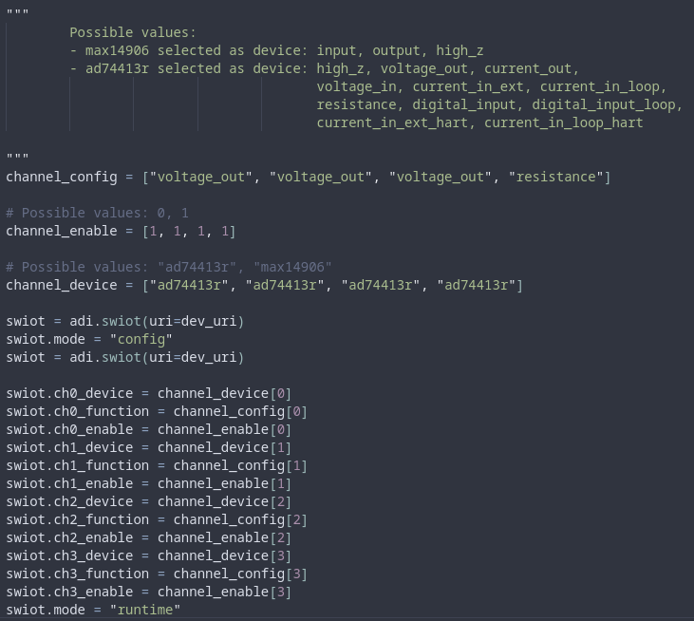
The Python code
Defines the channel configuration
Writes the appropriate IIO attributes for channel function configuration and enters runtime mode

Slide 45

The system for the workshop
T1L to USB
Supply
Potentiometer & LED
AD-SWIOT1L-SL
MAX32625PICO#

Slide 46

Exercise 1
Task: Power and RGB LED red, green and blue
Use the connector with RGB LED and plug it into the board
Write a for loop to power the led red, green and blue
Don't forget to turn off the led channels

Slide 47

Exercise 1 SOLUTION
Task: Power and RGB LED red, green and blue
Use the connector with RGB LED and plug it into the board
Write a loop to power the led red, green and blue
Don't forget to turn off the led channels

Slide 48

Exercise 2
Task: Adjust the brightness of an LED using a potentiometer
Use the connector with a potentiometer and LED and plug in into the board
Assign the value of the potentiometer to the adc channel and run your python file
Adjust the potentiometer and see how the led dims
Resistance / 1000

Slide 49

Exercise 2 SOLUTION
Continuously samples the potentiometer’s resistance and converts it into a voltage value on channel 0.

Slide 50

Exercise 3
Task: PID temperature control loop using a PWM-controlled fan
Use the connector with a fan and plug it into the board
Run the pid_control.py file and see how the pwm signal and speed adjust based on temperature
Make the pwm_output variable an input from the user and see how the duty cycle affects the speed of the fan

Slide 51
Questions?

